Slide 1
ERCOFTAC Overview
European Research Community in Flow, Turbulence and Combustion
Notes:
AI-generated content may be incorrect. --- ERCOFTAC is a leading European association in the field of turbulence research and engineering. In this presentation, we will explore the mission, structure, and benefits of ERCOFTAC.

Slide 2
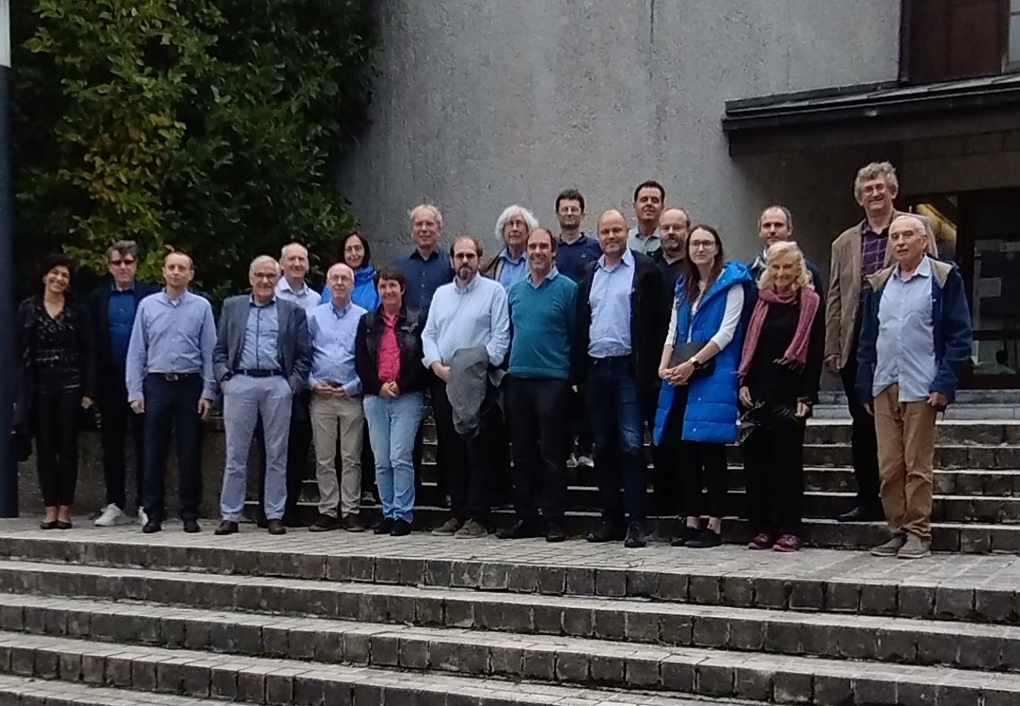
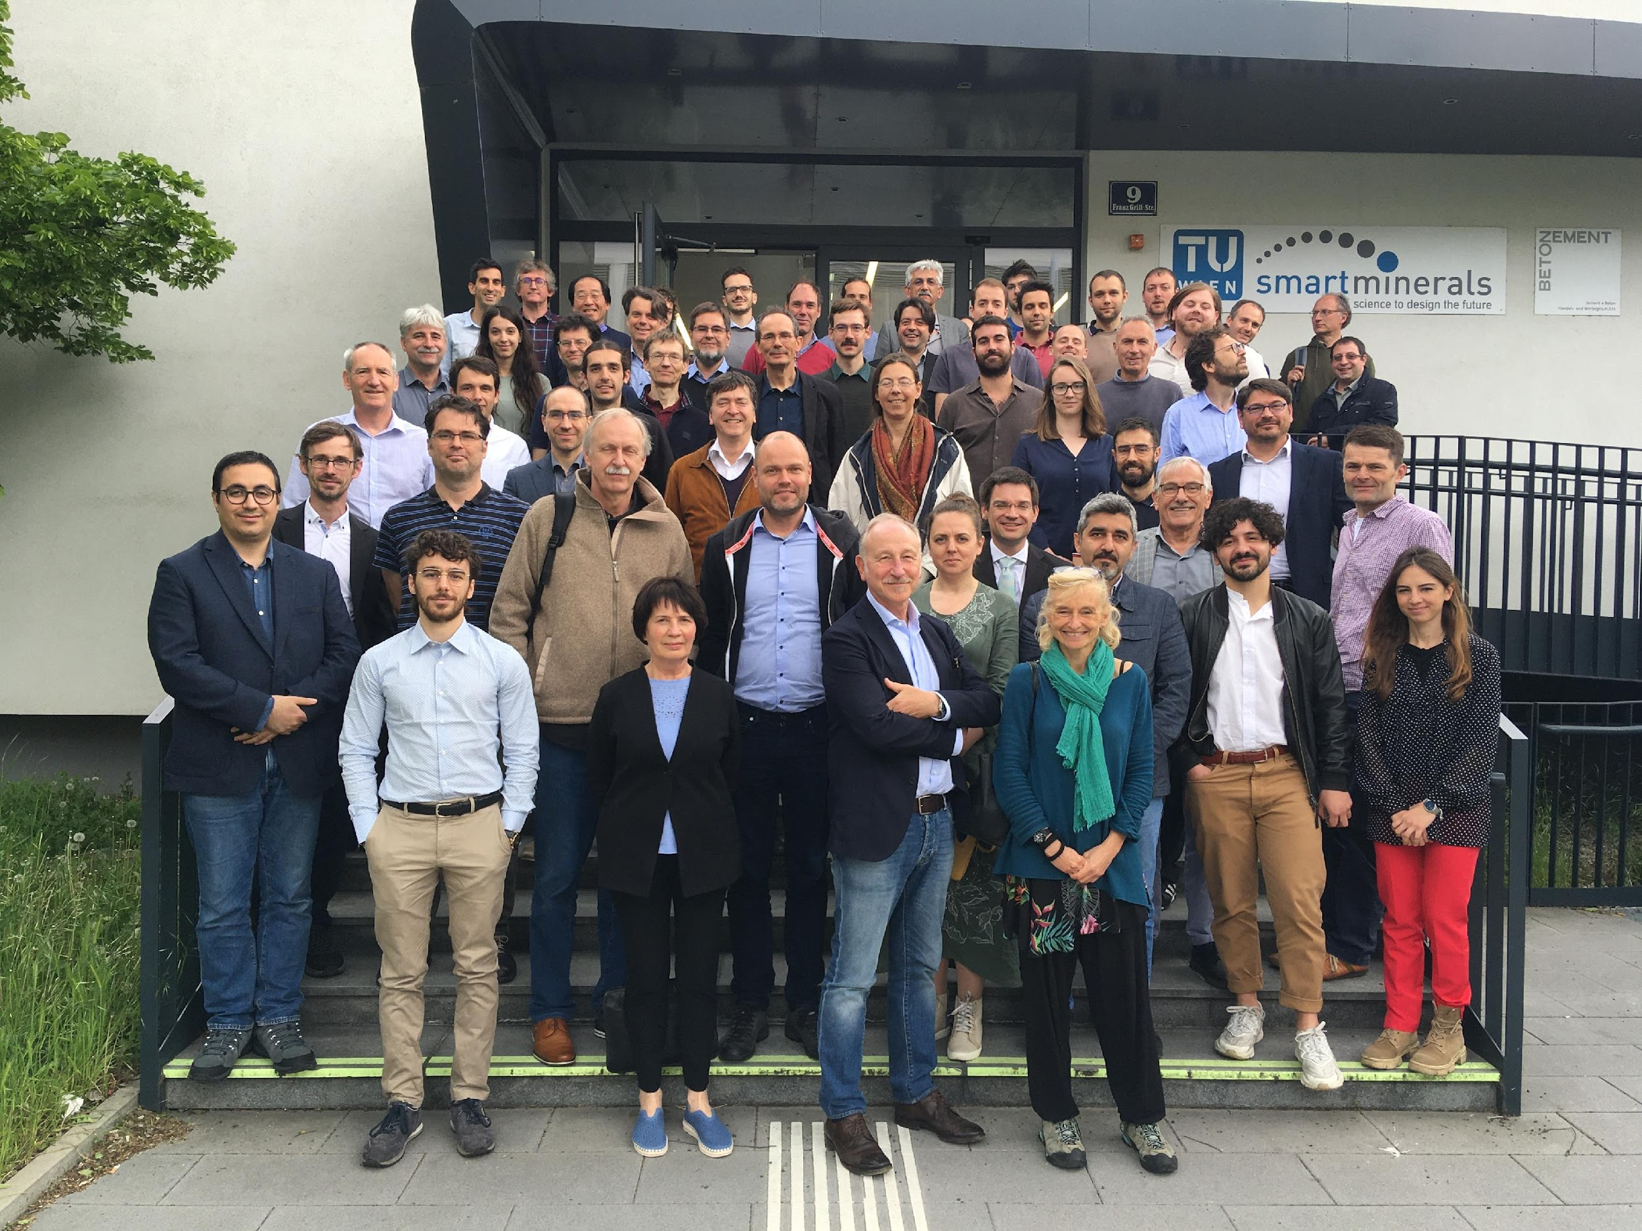
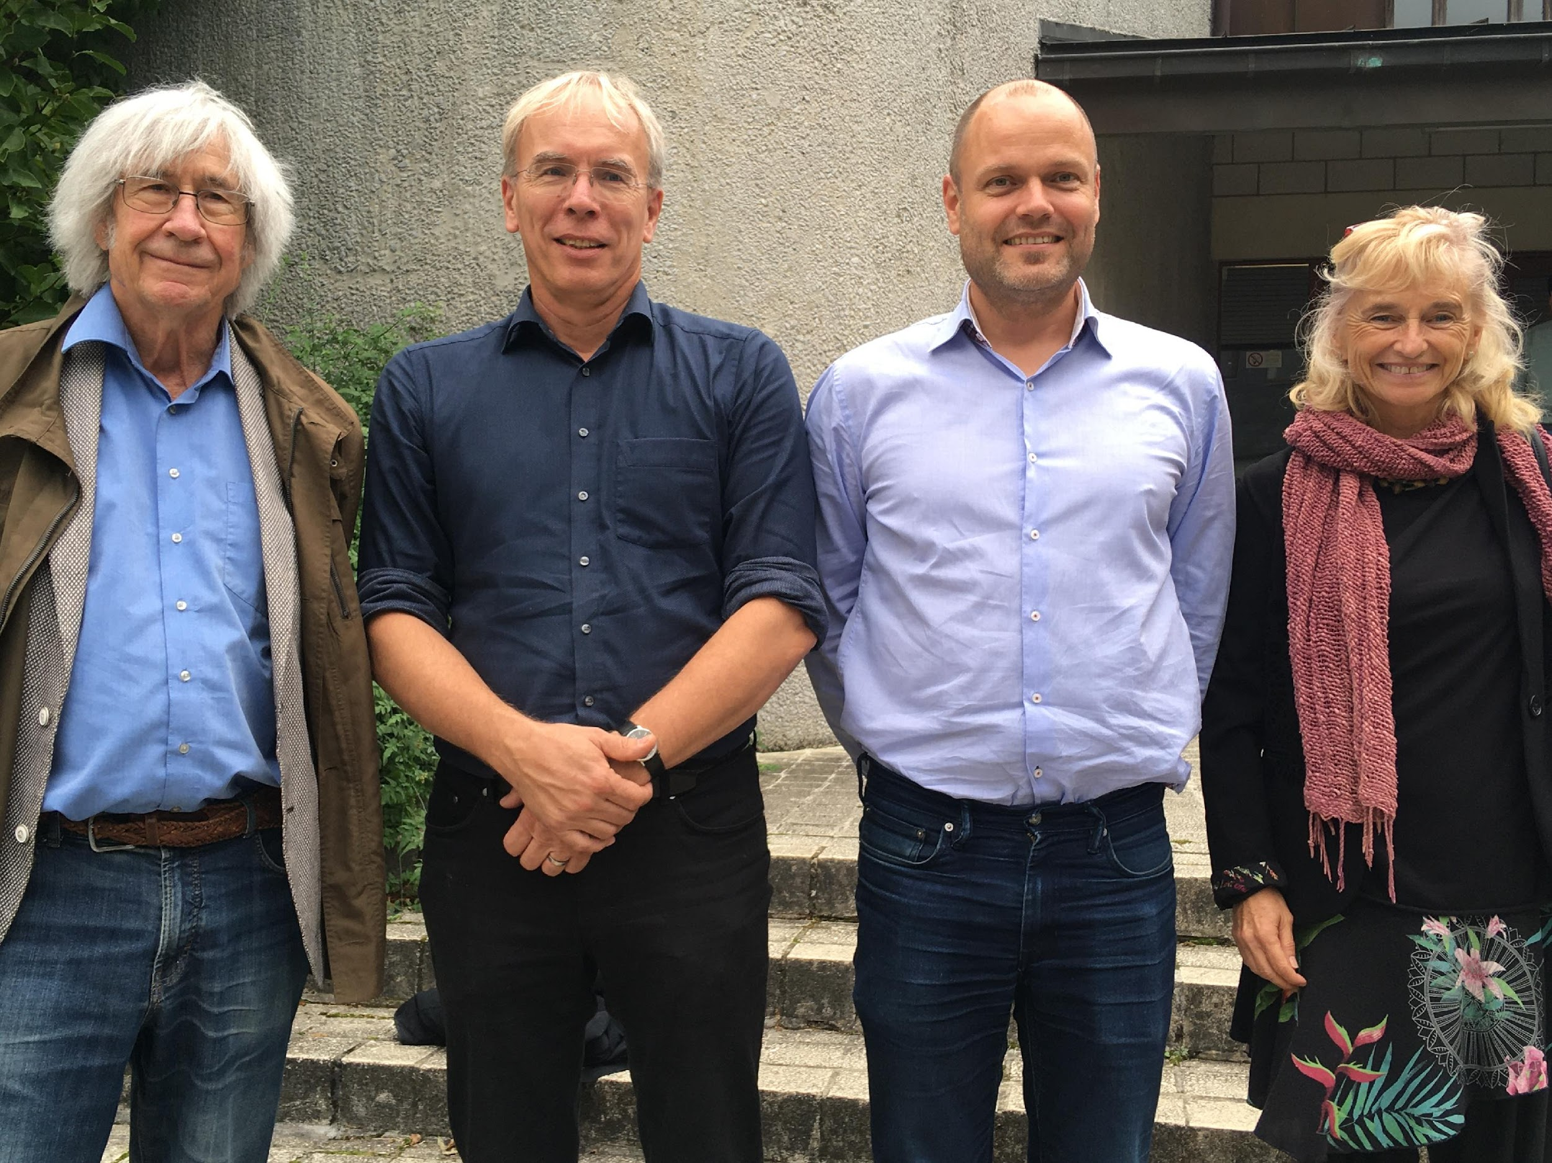
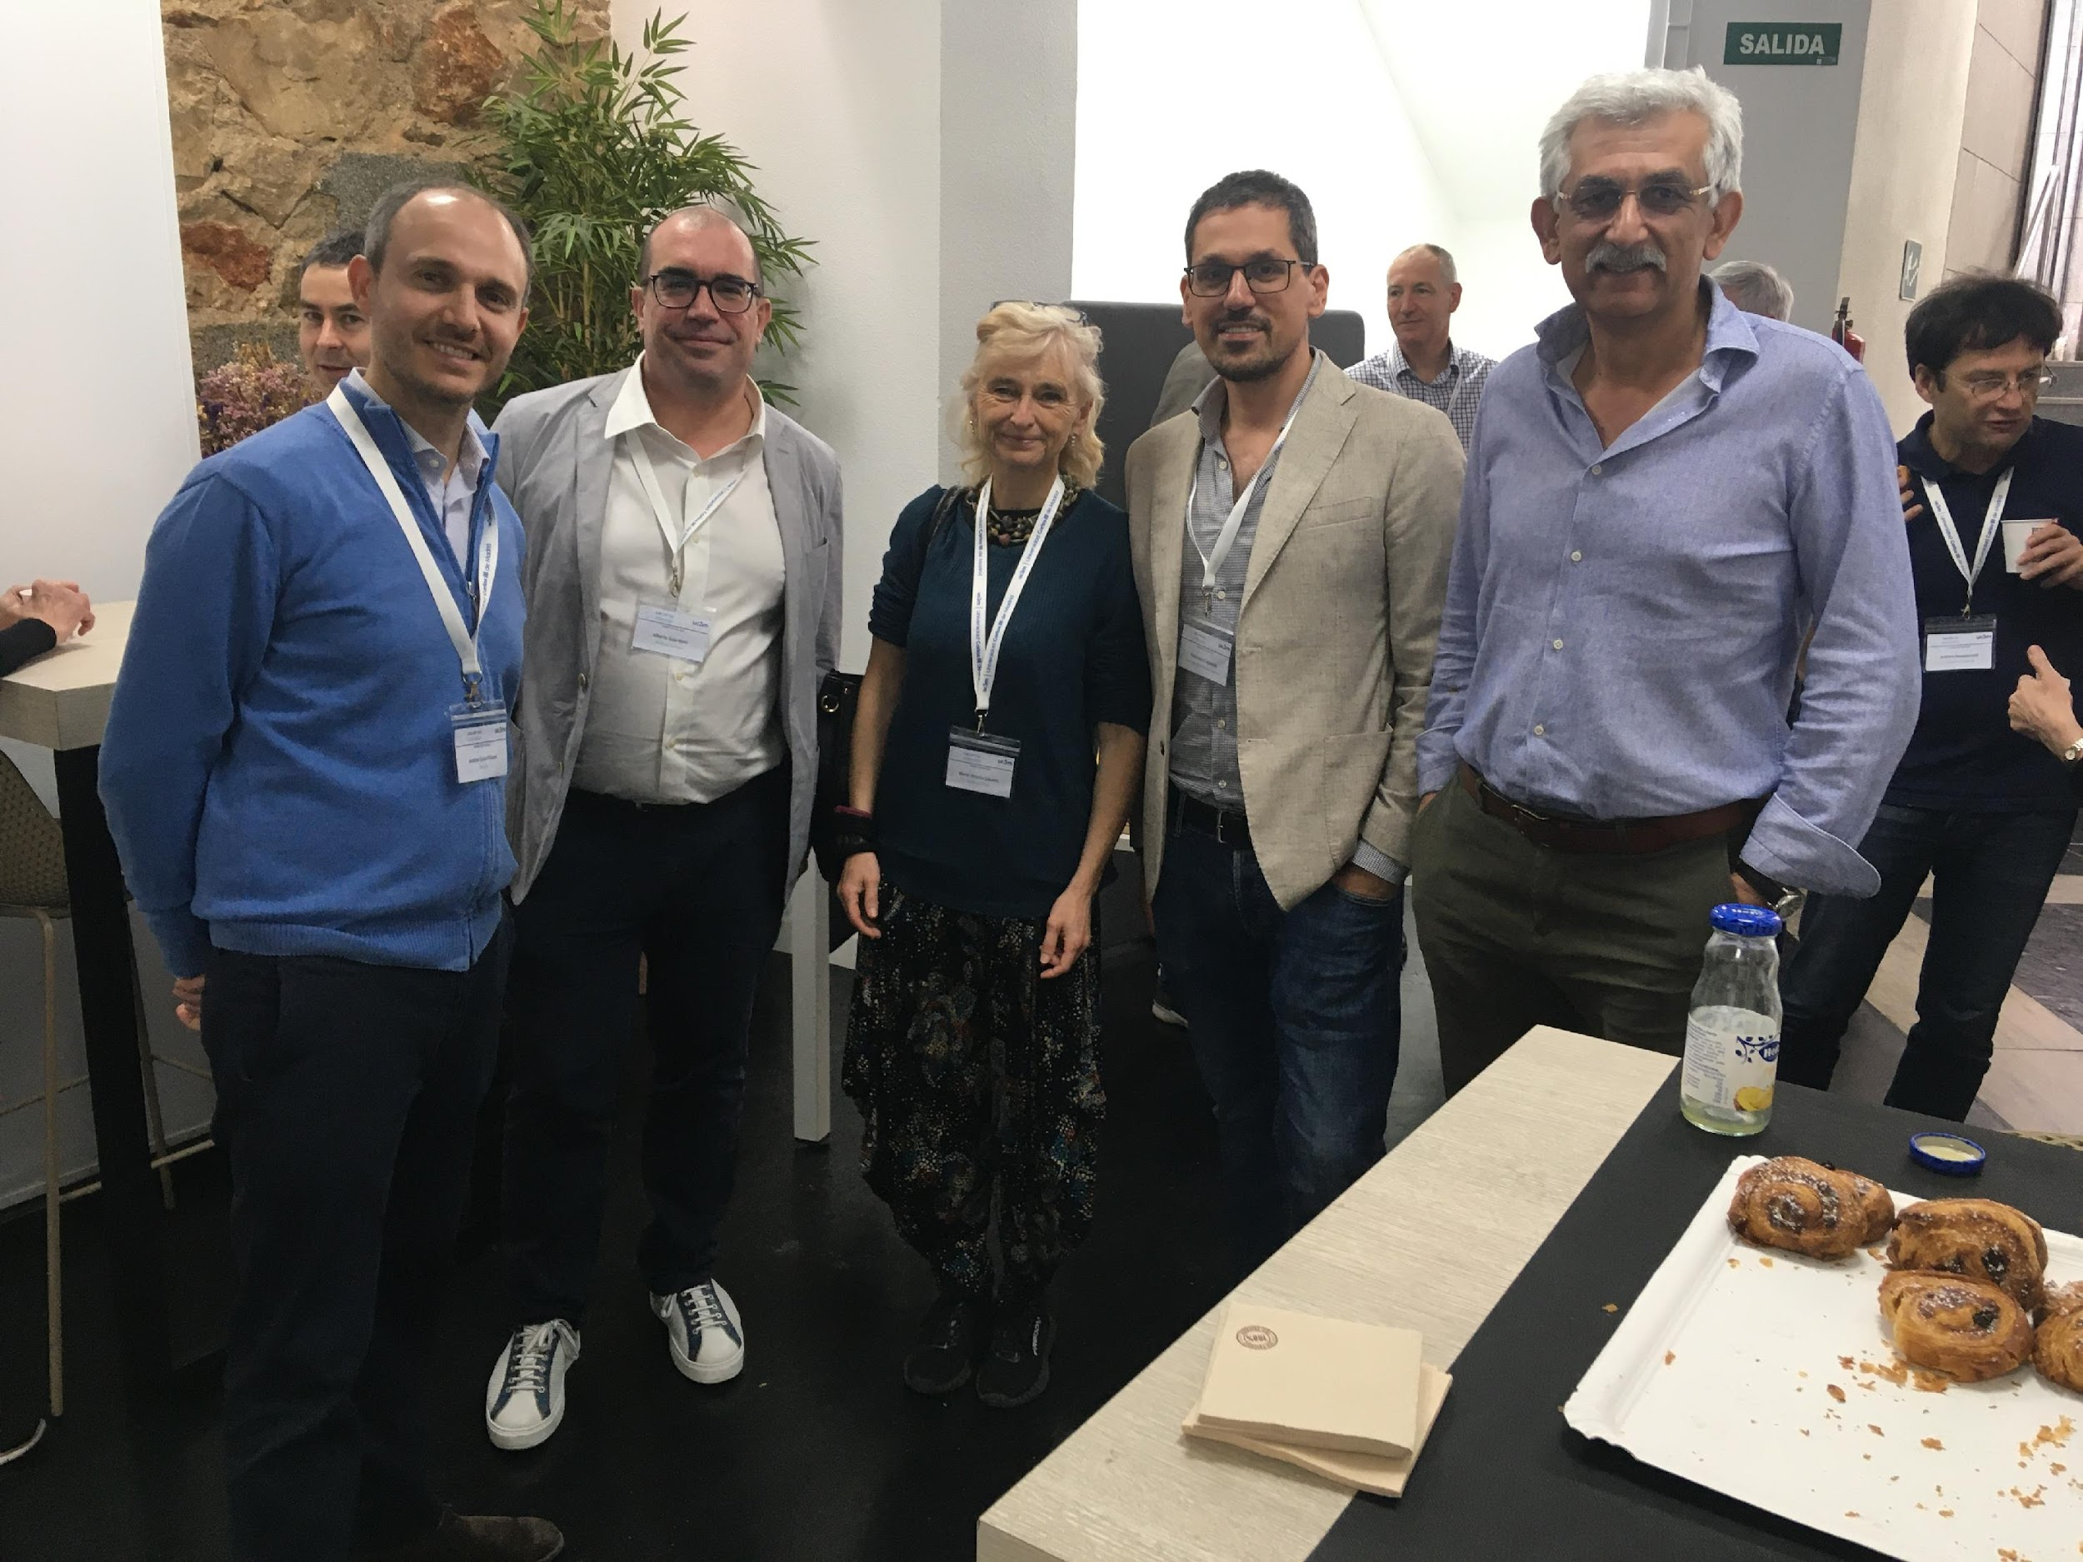
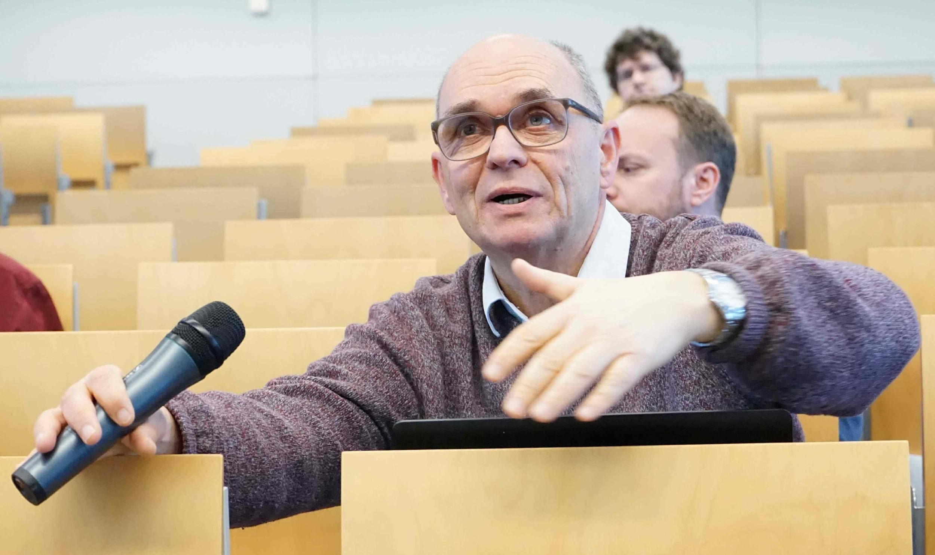
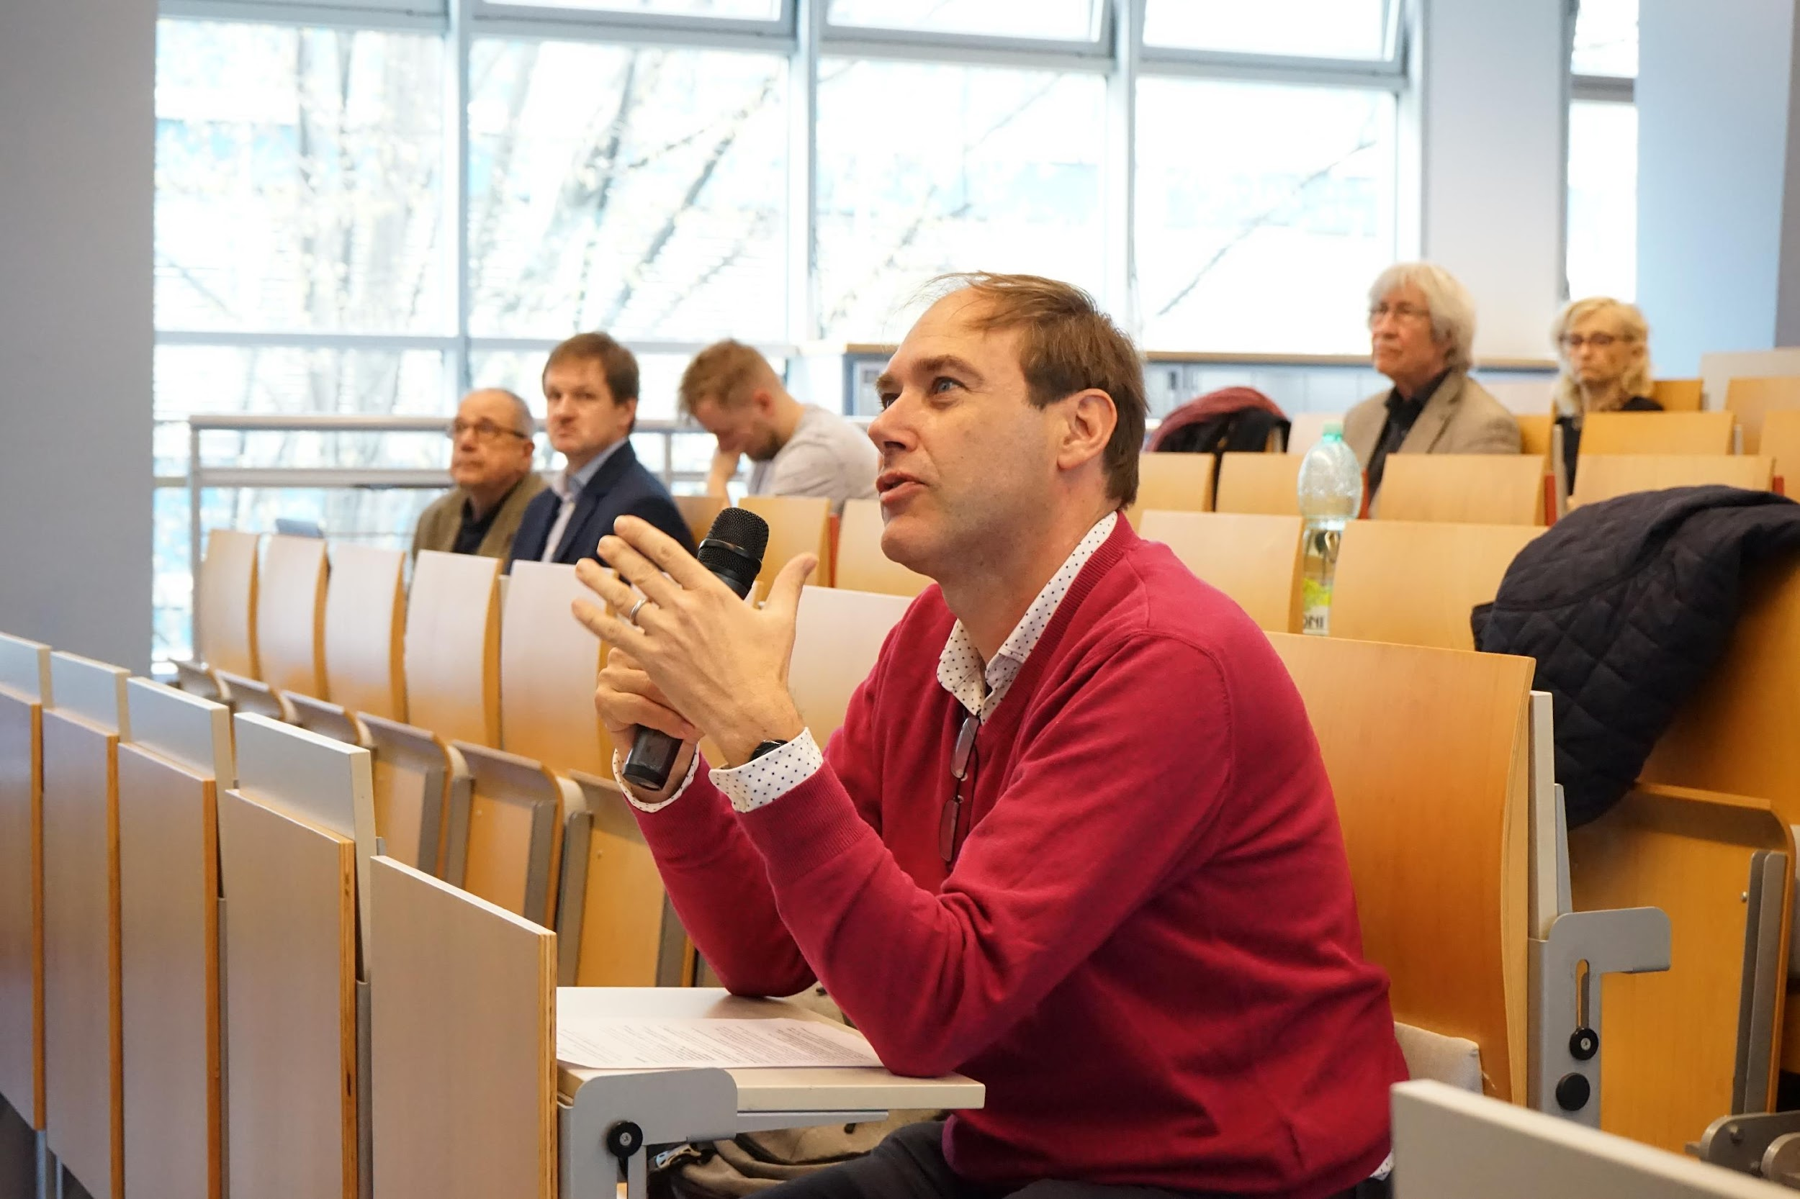
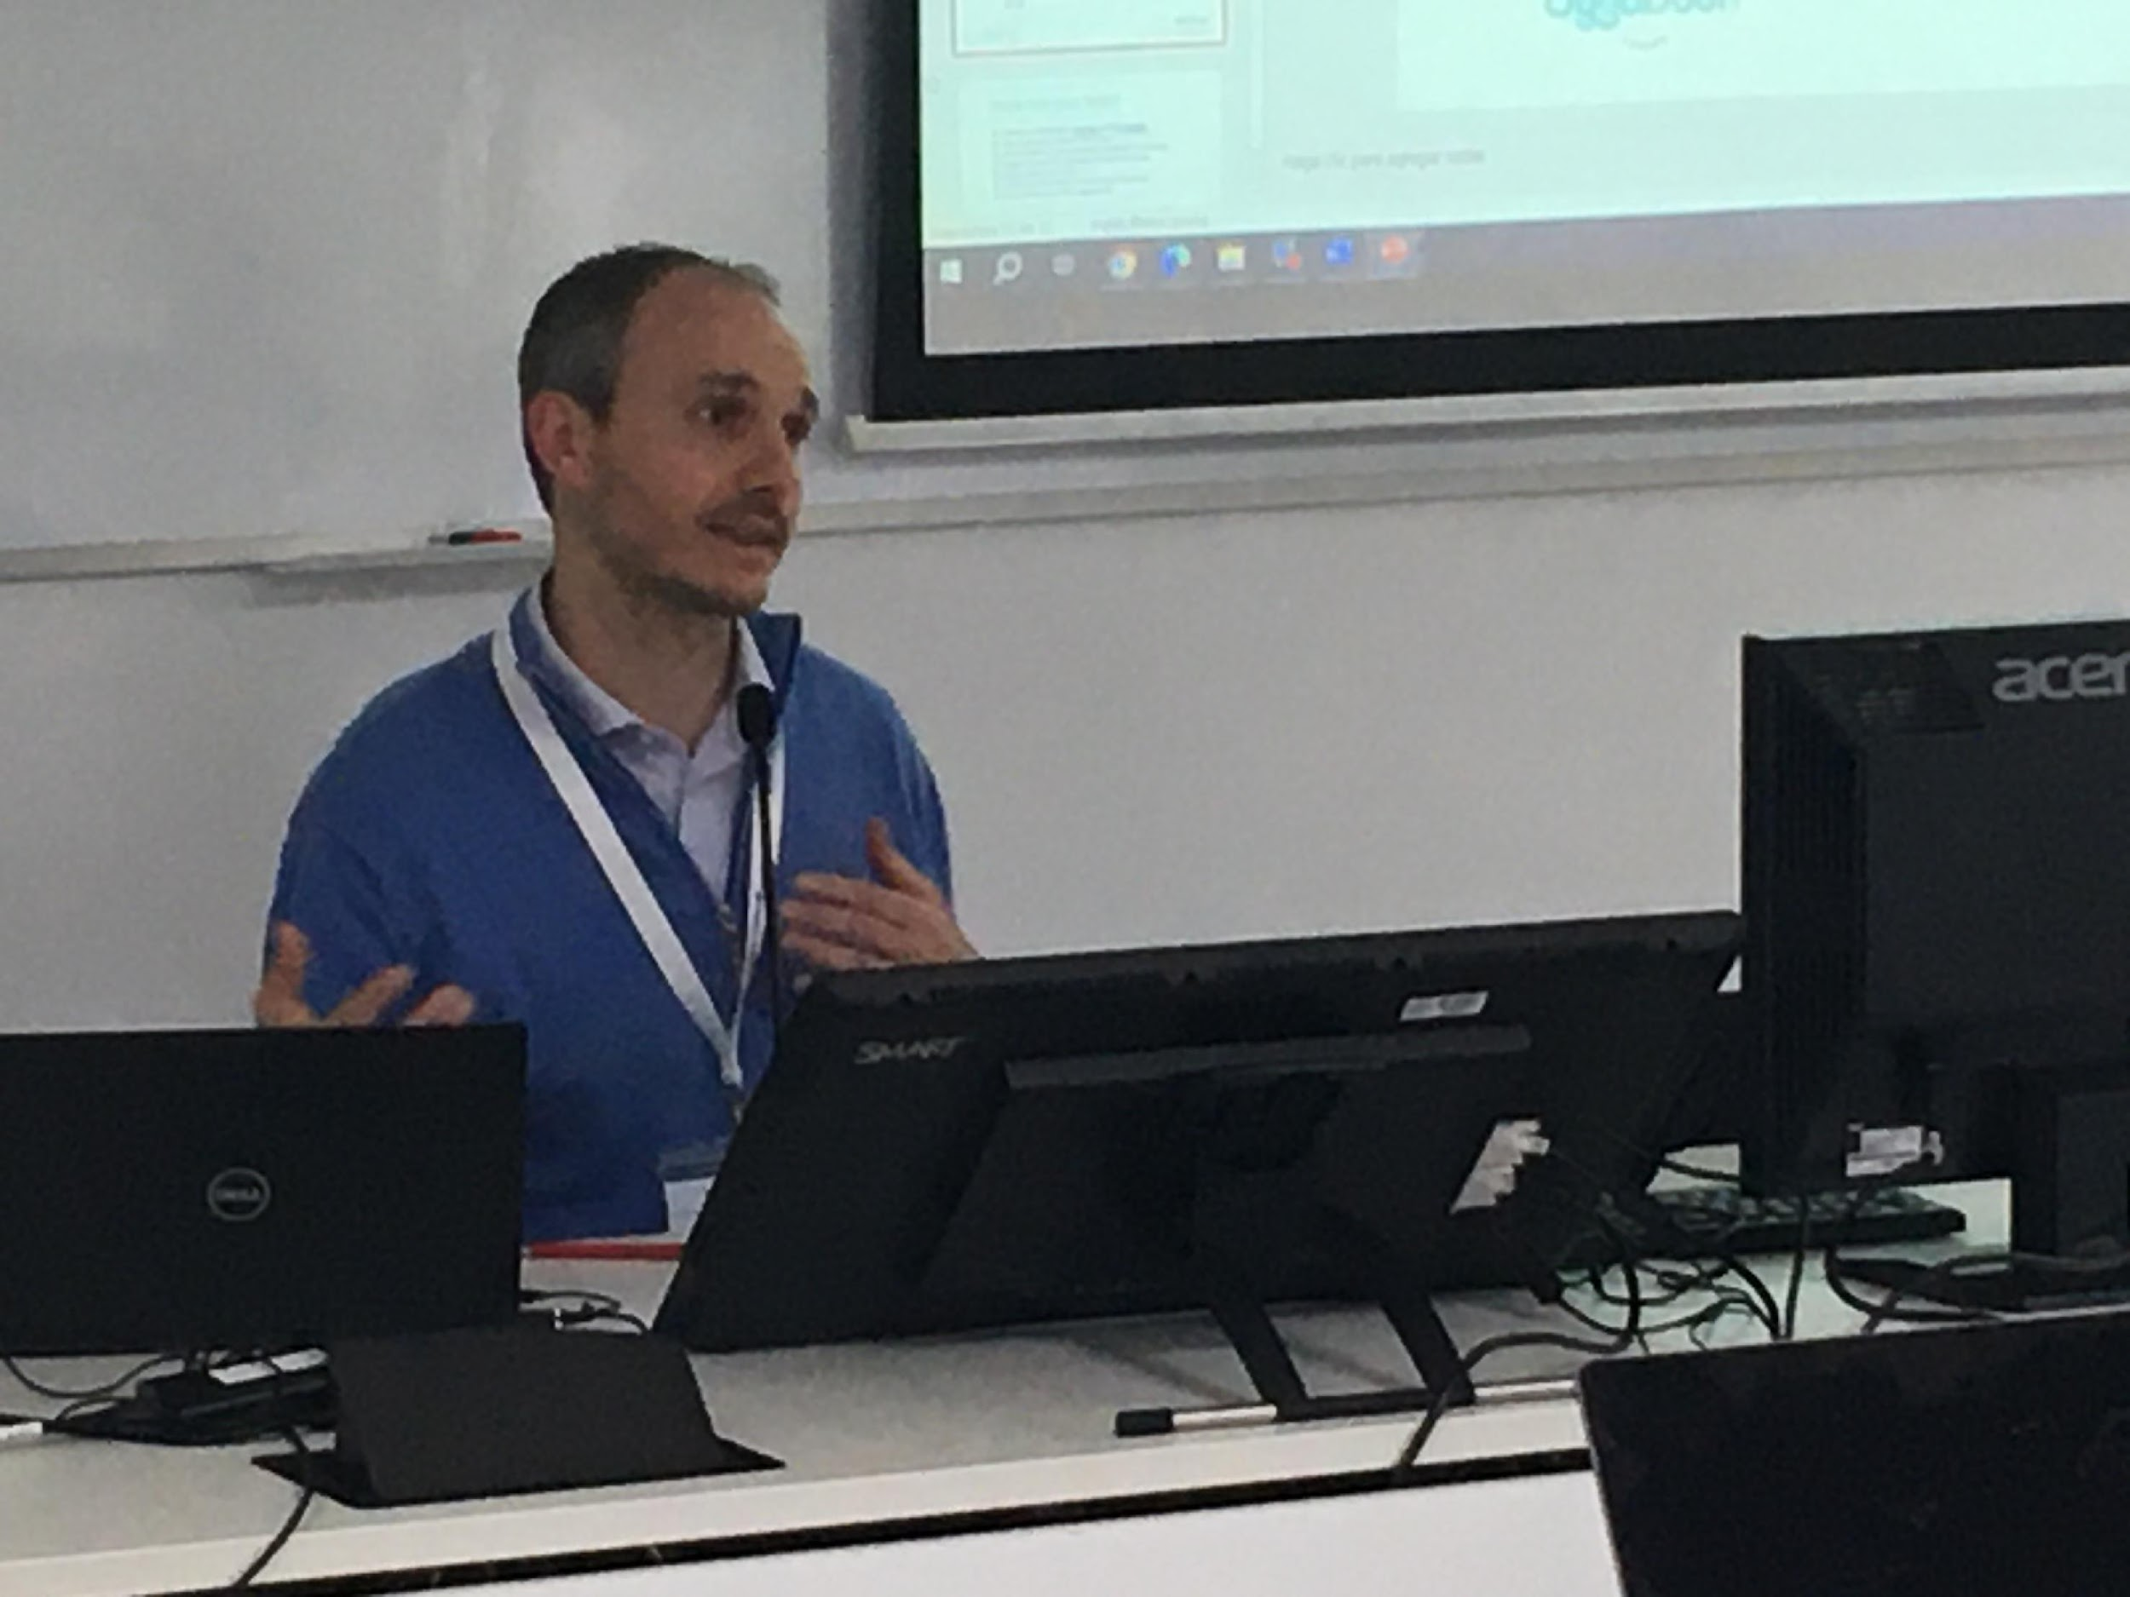
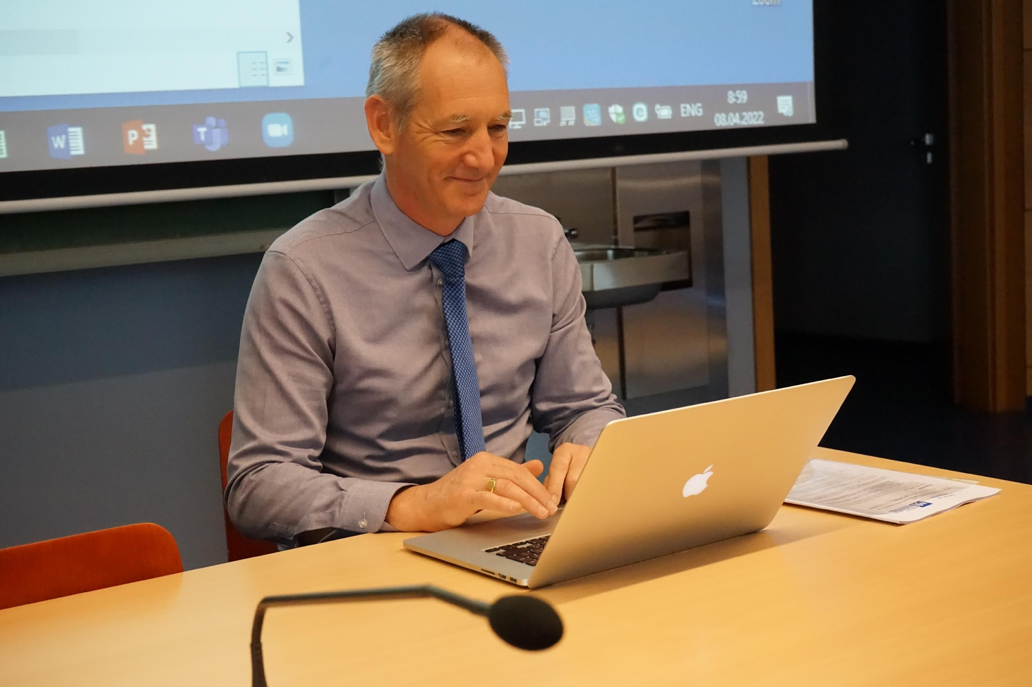

Slide 3
Who we are
ERCOFTAC is a global non-profit association, founded in 1988, that unites over 500 members from universities, research institutions, and industry partners. Our members come from a range of fields, including fluid mechanics, physics, mathematics, and engineering.
Mission
ERCOFTAC fosters collaboration on all aspects of fluid mechanics, including flow, turbulence, and combustion, to address the challenges of the field.
https://www.ercoftac.org
Notes:
ERCOFTAC is a non-profit association that was founded in 1988. We are a network of over 500 members, including universities, research institutions, and industry partners. Our members come from a range of fields, including fluid mechanics, physics, mathematics, and engineering.

Slide 4
Structure of ERCOFTAC
General Assembly (GA) - top level decision making body in ERCOFTAC. It is composed of representatives of each voting member, and meets in general once per year.
ERCOFTAC Council (EC) management board, composed of elected representatives of the voting members. The Council elects among its members a Chairperson, a Deputy Chairperson, and a Treasurer.
Knowledge Network Committee (KNC)
it advises on, and clarifies, 21st century industrial needs and provides products & services to meet those needs by drawing on ERCOFTAC's strong scientific base.
Scientific Programme Committee (SPC) it recommends the research goals of ERCOFTAC and proposes special activities.
Pilot Centres (PCs) one of the pillars of the ERCOFTAC Association composed of ERCOFTAC members in a region or a country. PCs coordinate research on a regional or national scale, while at the same time being linked to all other Pilot Centres via Special Interest Groups.
Special Interest Groups (SIGs)
ERCOFTAC Special Interest Groups form the second pillar of the Association. SIGs are composed of ERCOFTAC members working together and organizing activities in a well defined specific topic.
https://www.ercoftac.org/about/structure_of_the_association/
Notes:
ERCOFTAC has a robust organizational structure that includes a Board of Directors, a Scientific and Technical Committee, and a Secretariat. We also have a network of working groups that focus on specific areas of turbulence research.

Slide 5
ERCOFTAC Council (EC)
Chairperson: Prof Dominic VON TERZI
First Deputy Chairperson: Dr David STANDINGFORD
Second Deputy Chairperson: Prof Charles HIRSCH
Treasurer: Prof Stefan HICKEL
Deputy Treasurer: Prof Ananias TOMBOULIDES
SPC Chairperson: Prof Maria Vittoria SALVETTI
SPC Deputy Chairperson : Prof Paola CINNELLA
KNC Chairperson: Dr Andrea SCIACCHITANO
KNC Deputy Chairperson: Dr Koen HILLEWAERT
KNC Second Deputy Chairperson: Prof Tomas Bodnar
Knowledge Base Editor: Prof Wolfgang RODI
Bulletin Editor: Prof Witold ELSNER
https://www.ercoftac.org/about/structure_of_the_association/

Slide 6
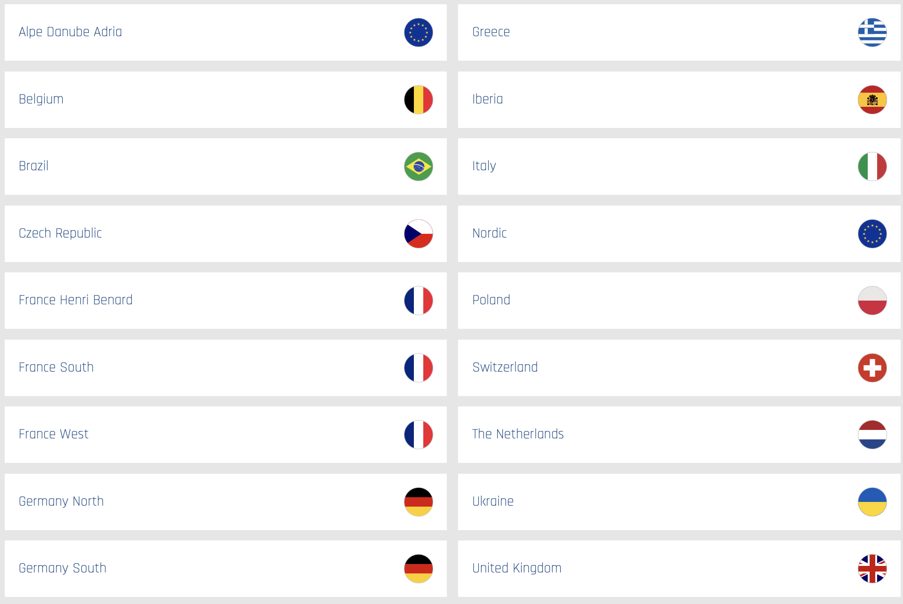
Pilot Centres (PCs)
Pilot Centres exist to coordinate research in Flow, Turbulence, and Combustion on a regional or national scale, while at the same time being linked to all other PCs via ERCOFTAC's SIGs
Currently there are 17 PCs
https://www.ercoftac.org/pilot_centres/
Notes:
ERCOFTAC has a robust organizational structure that includes a Board of Directors, a Scientific and Technical Committee, and a Secretariat. We also have a network of working groups that focus on specific areas of turbulence research.

Slide 7
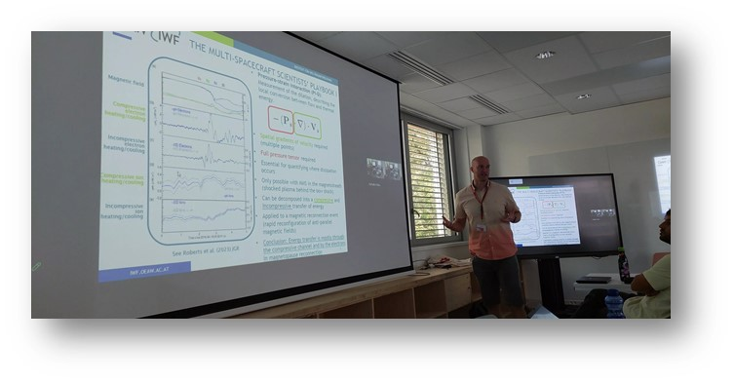
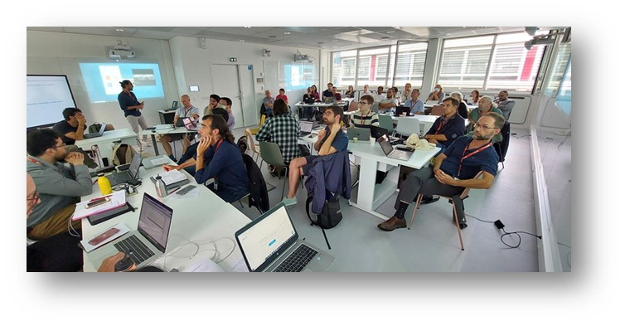
Special Interest Groups (SIGs):
SIGs are composed of ERCOFTAC members working together on a well-defined specific topic on Flow, Turbulence and Combustion, as for instance:
instability
transition
aero acoustics
combustion
LES
PIV
machine learning
and other experimental techniques
https://www.ercoftac.org/special_interest_groups/

Slide 8
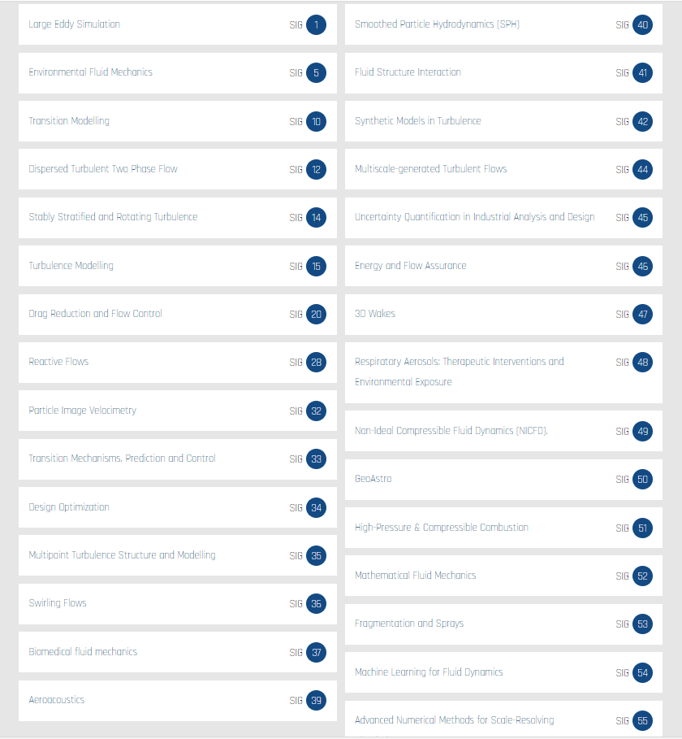
Special Interest Groups (SIGs):
Role and activities:
workshops, summer schools, conferences and courses: ERCOFTAC funding can apply administrative support and website functionality for all the events
comparison of codes
exchange of research results and possibility to cooperate and fusion
creation of experimental and/or numerical data bases
industrial courses organisation with administrative support and website functionality for the course
https://www.ercoftac.org/special_interest_groups/

Slide 9
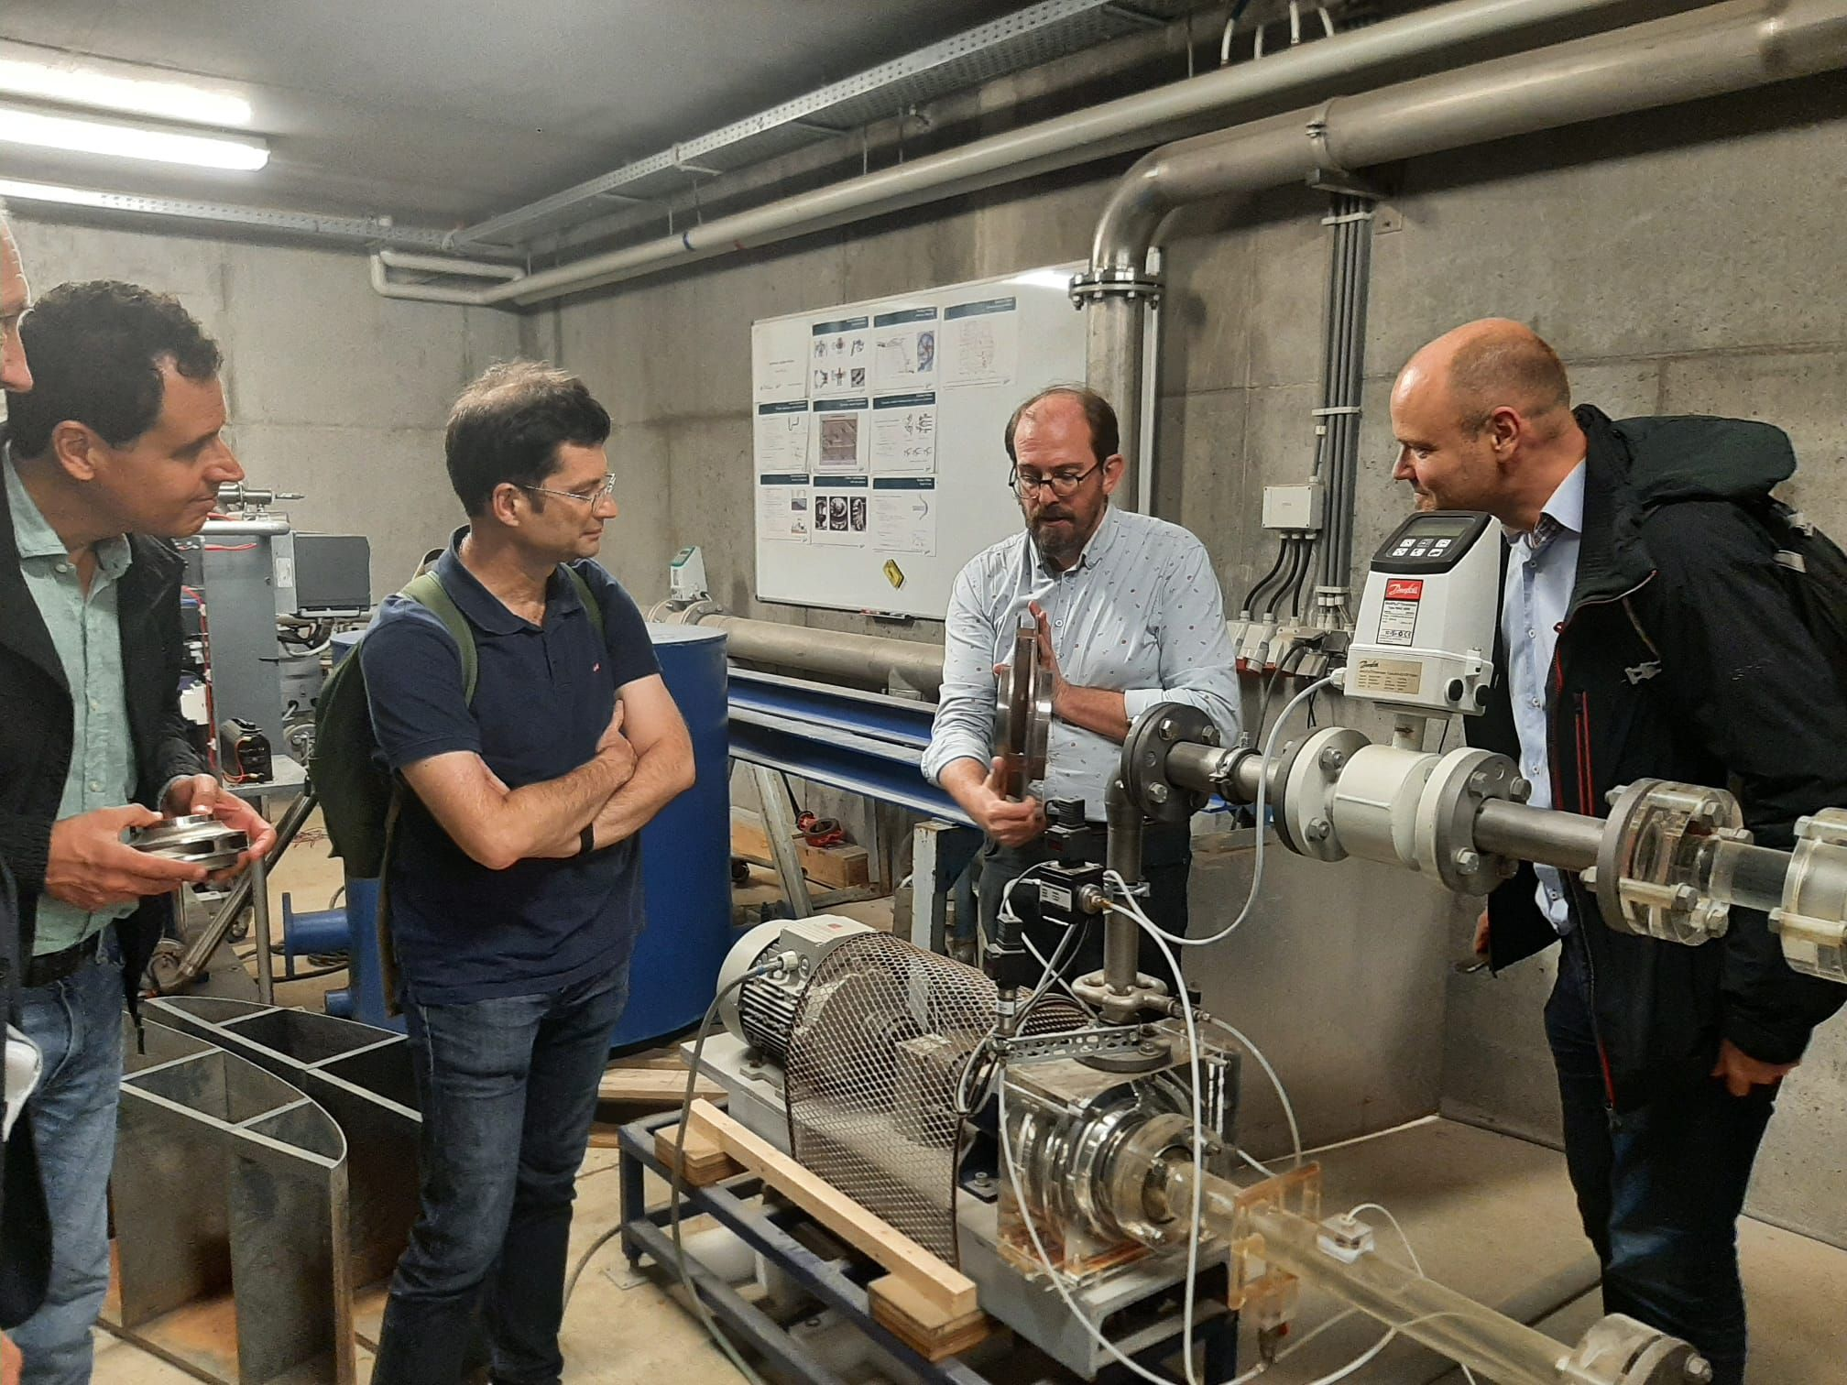
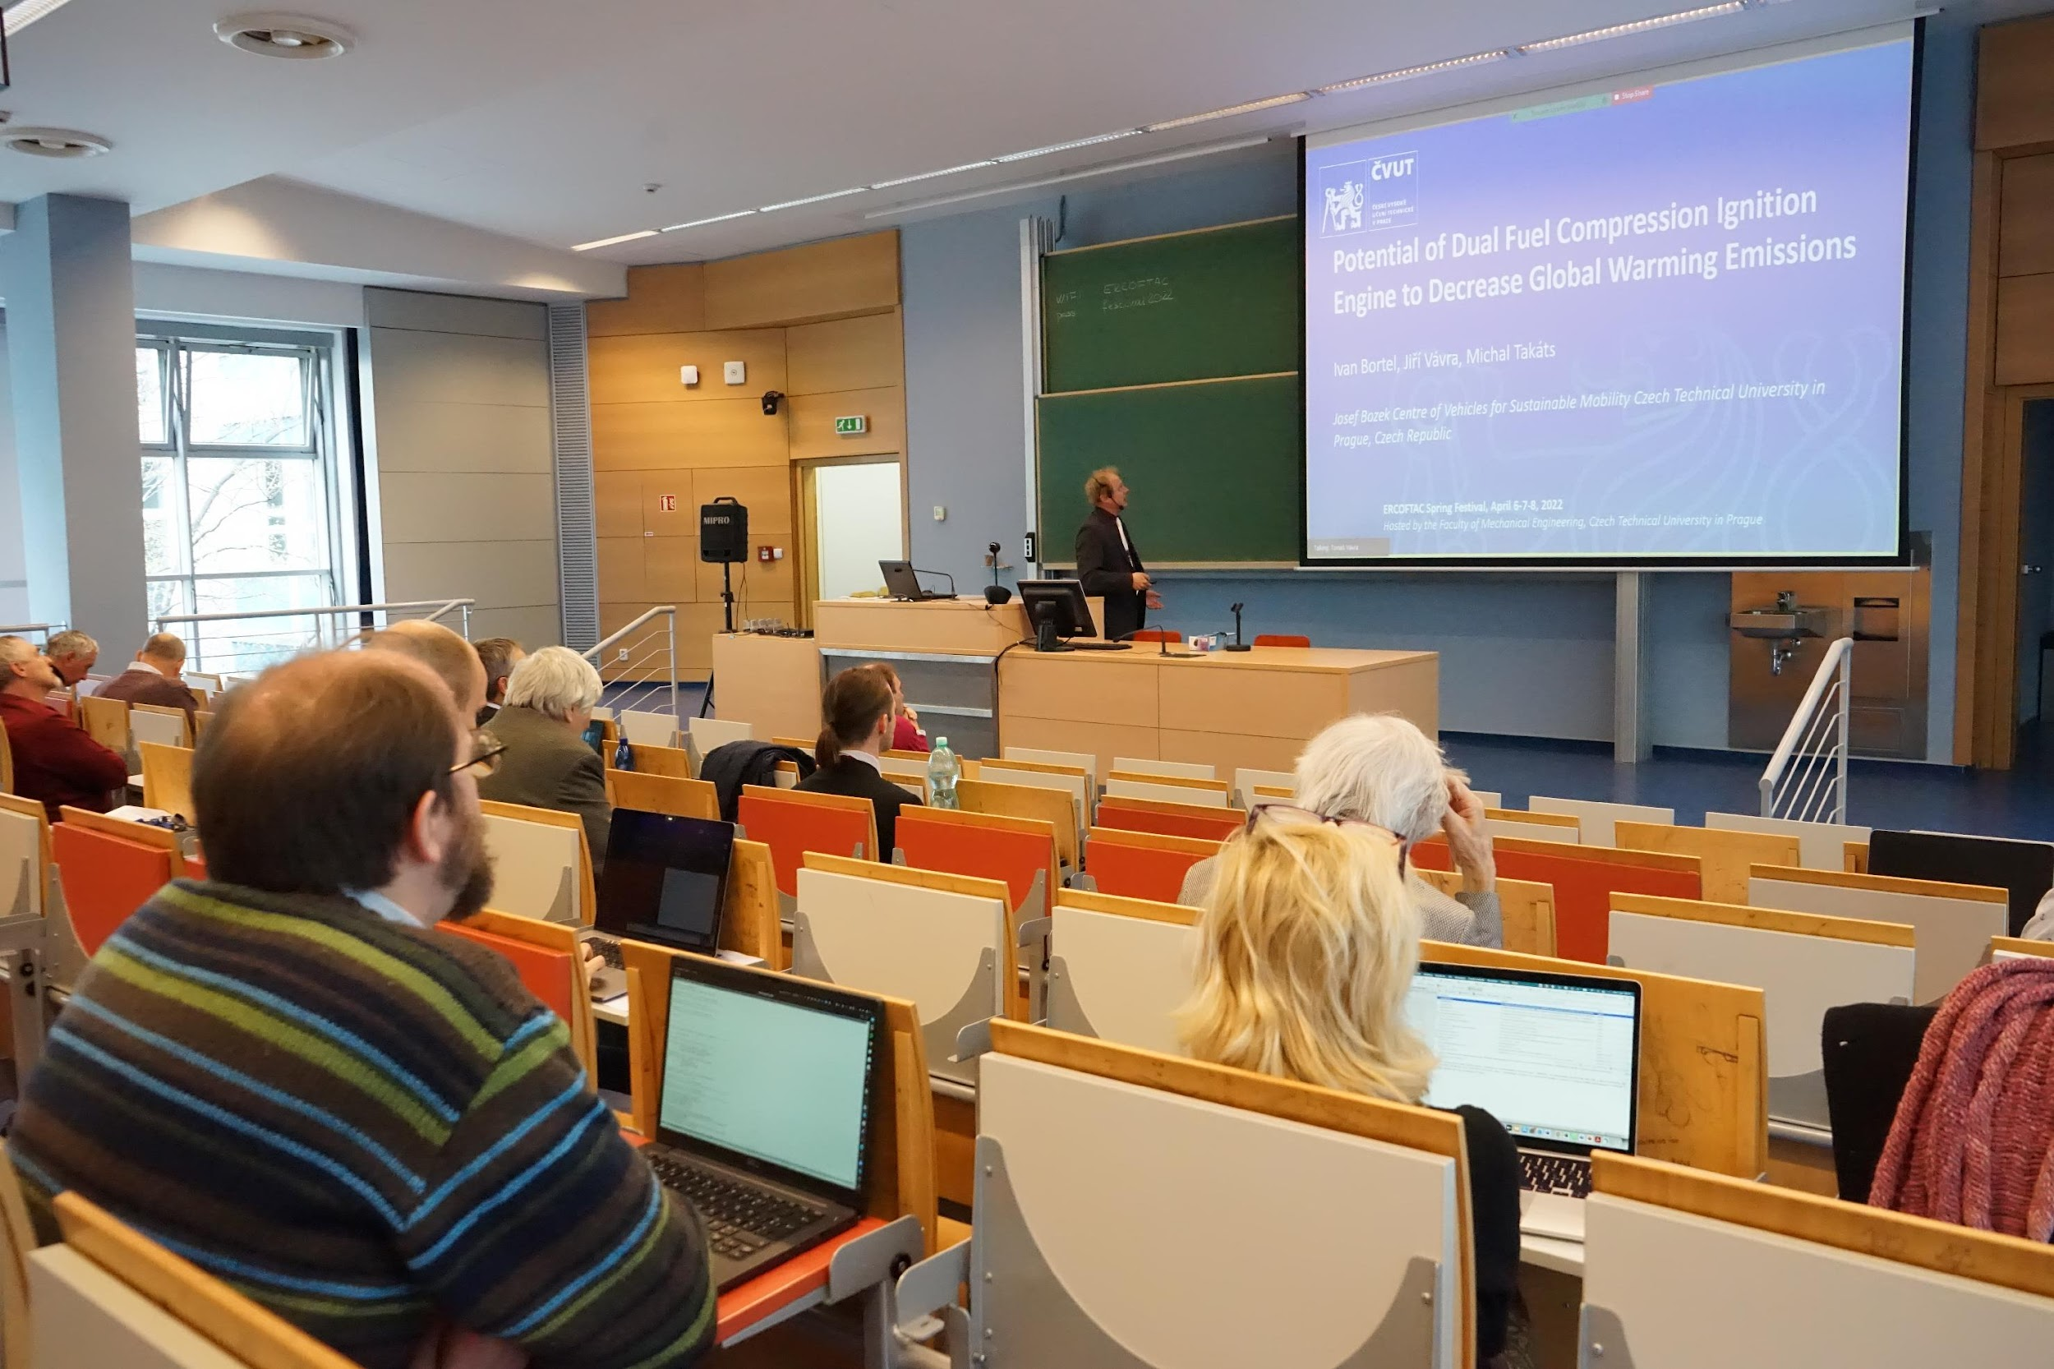
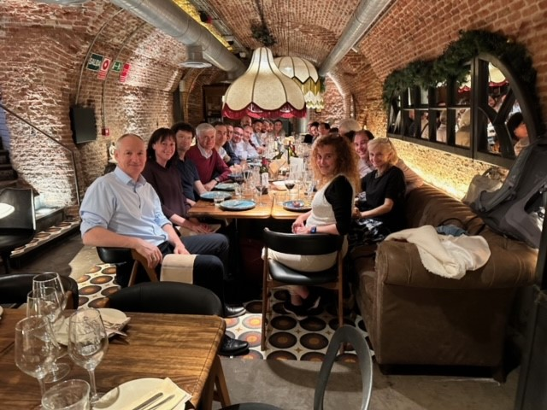
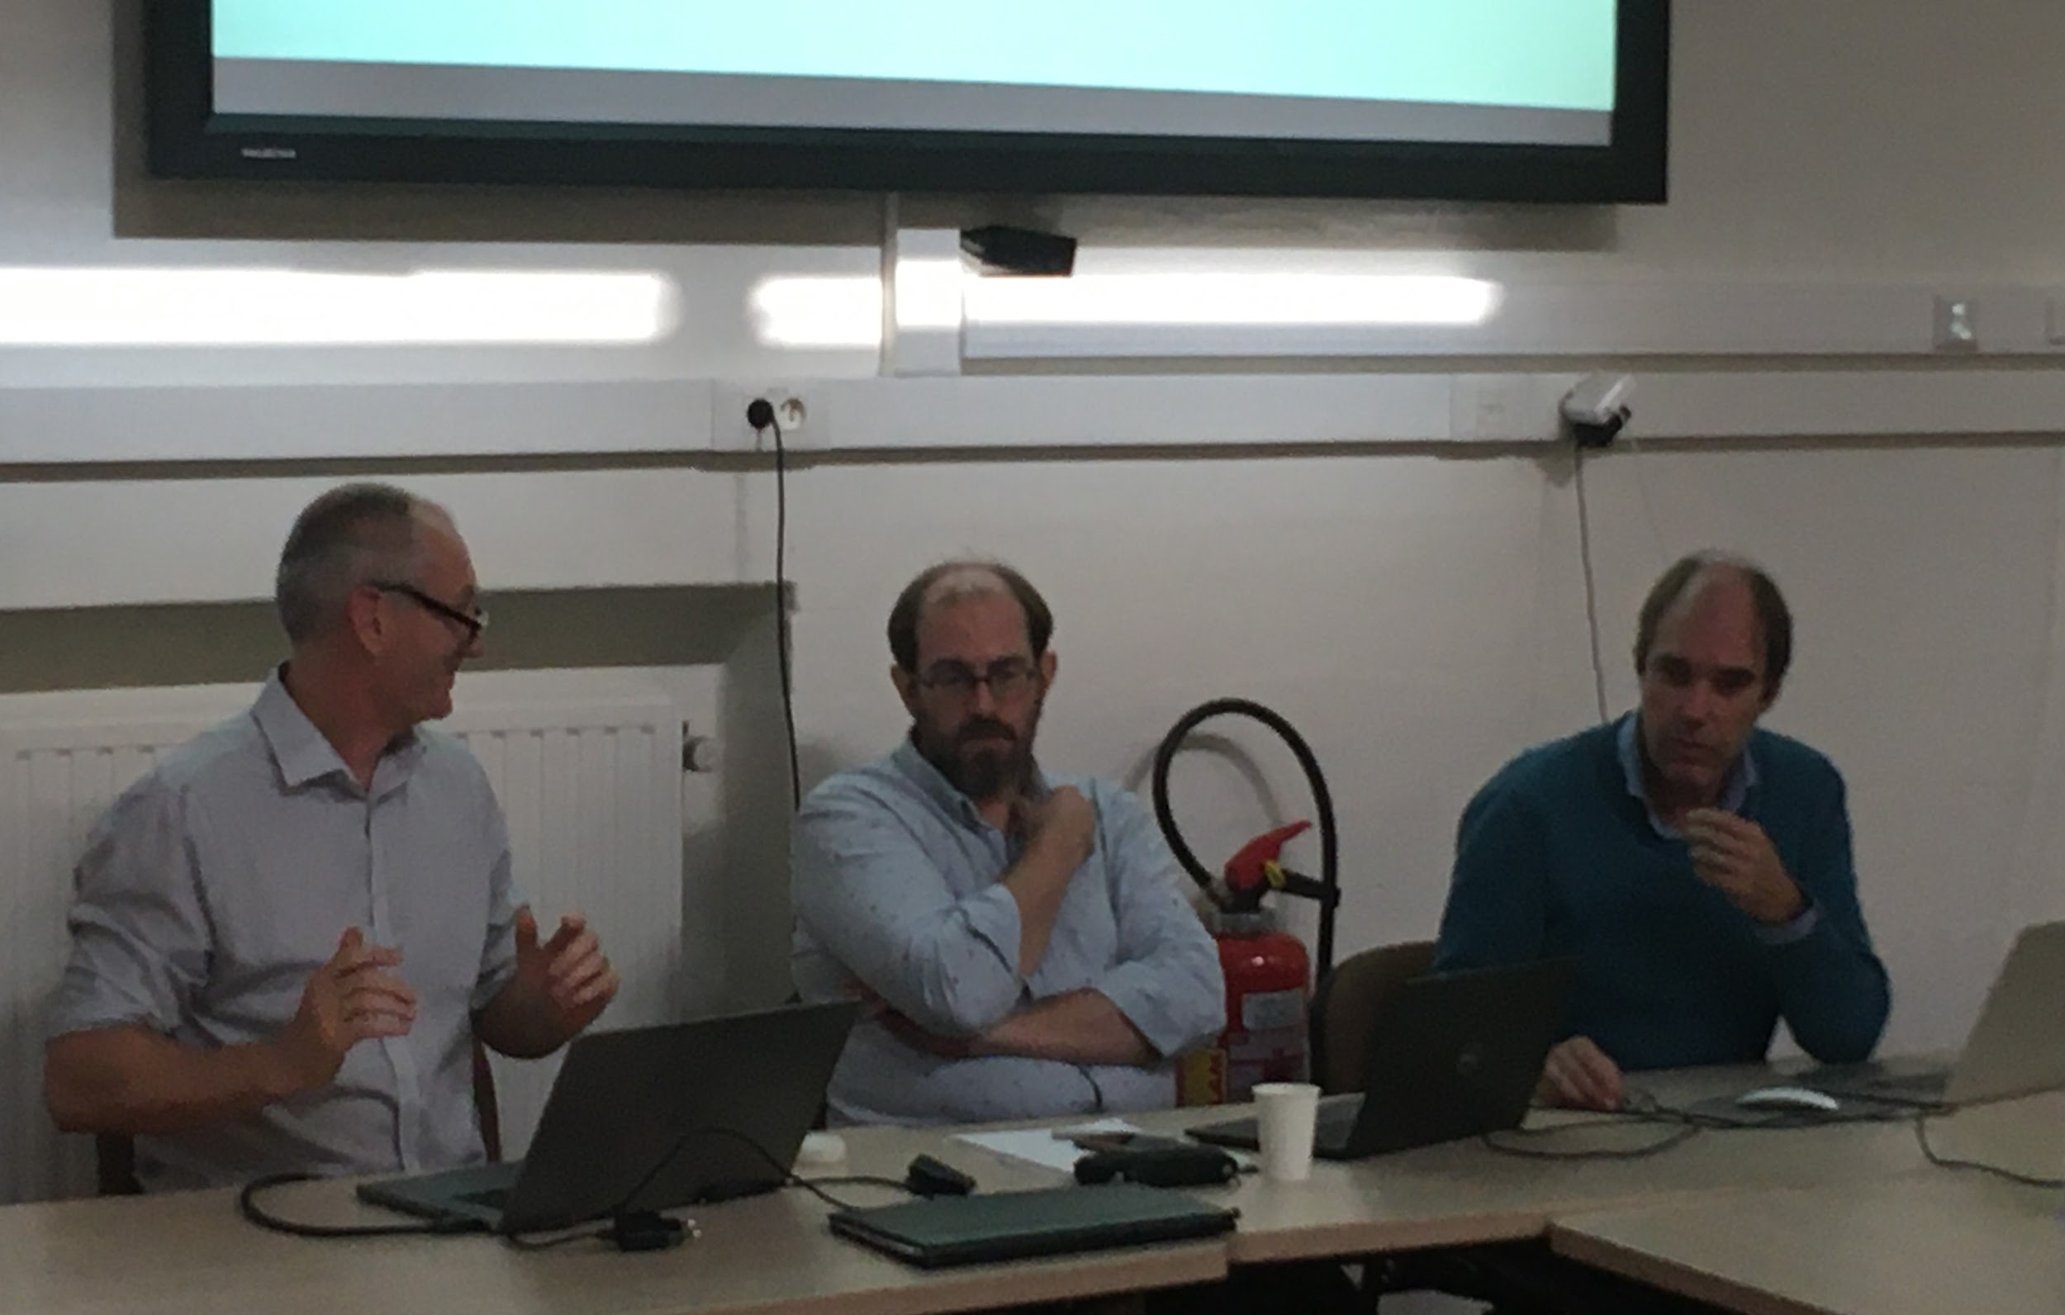
ERCOFTAC Autumn and Spring Festivals
Role and Aim:
Twice a year one of the Pilot Centres (PCs) organises ERCOFTAC Festival: Spring and Autumn
Two days events are open to all members to attend and exchange, discuss and socialise with other members
First day of the Festivals is for the local PC to present the facilities, activities and research taking place within their PC and also show its role within the community
Second day is for the technical ERCOFTAC committee meetings lead by officials to discuss the strategy and future events taking place under ERCOFTAC.
Input and opinion from all members is always considered, highly appreciated and very welcome!
Lab visits
PC Presentations
Gala Dinner
Committee Meetings

Slide 10
The recent Spring Festival 2025 was organised by PC Nordic and took place at KTH, Stockholm, Sweden. The local organiser, Dr Stefan Wallin and Dr Ardeshir Hanifi, invited remarkable speakers and their presentations are now available on the ERCOFTAC website: ERCOFTAC - Spring Festival 2025: PC Nordic - Overview During this Spring Festival the 1st edition of ERCOFTAC Milton van Dyke competition took place.
ERCOFTAC Autumn and Spring Festivals
Next Festival, Autumn Festival, will be organised by PC Germany and will take place on the 9th – 10th October 2025.
All members are welcome to attend!
https://www.ercoftac.org/about/ercoftac-festivals/

Slide 11
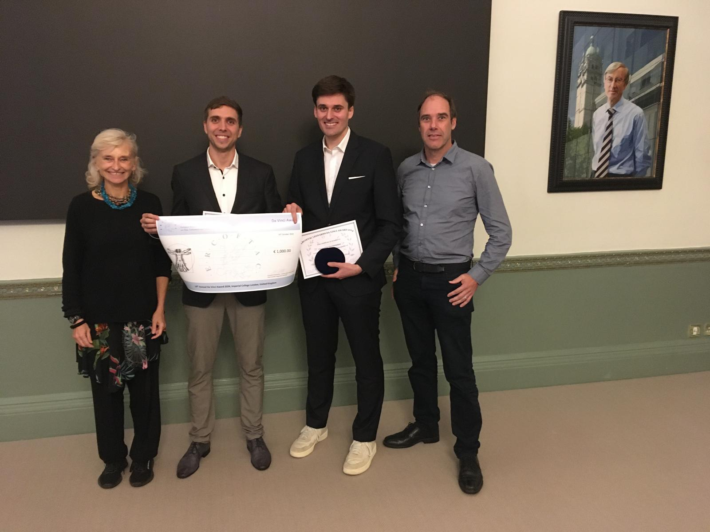
Da Vinci Competition and €1,000 Prize
Annual prize awarding young researchers in recognition of an excellent PhD thesis in theoretical and applied fluid dynamics and outstanding scientific contributions with engineering relevance
The winner of the da Vinci Competition receives €1,000 and is chosen from five finalists during the ERCOFTAC Autumn Festivals
ERCOFTAC PC Coordinators provide the best nominations
SPC Chair Prof Maria Vittoria Salvetti, Da Vinci Finalists 2024: Christopher Geschwindner, Matthias Steinhausen and ERCOFTAC Chairman: Prof Dominic von Terzi
https://www.ercoftac.org/about/ercoftac-da-vinci-competition/

Slide 12
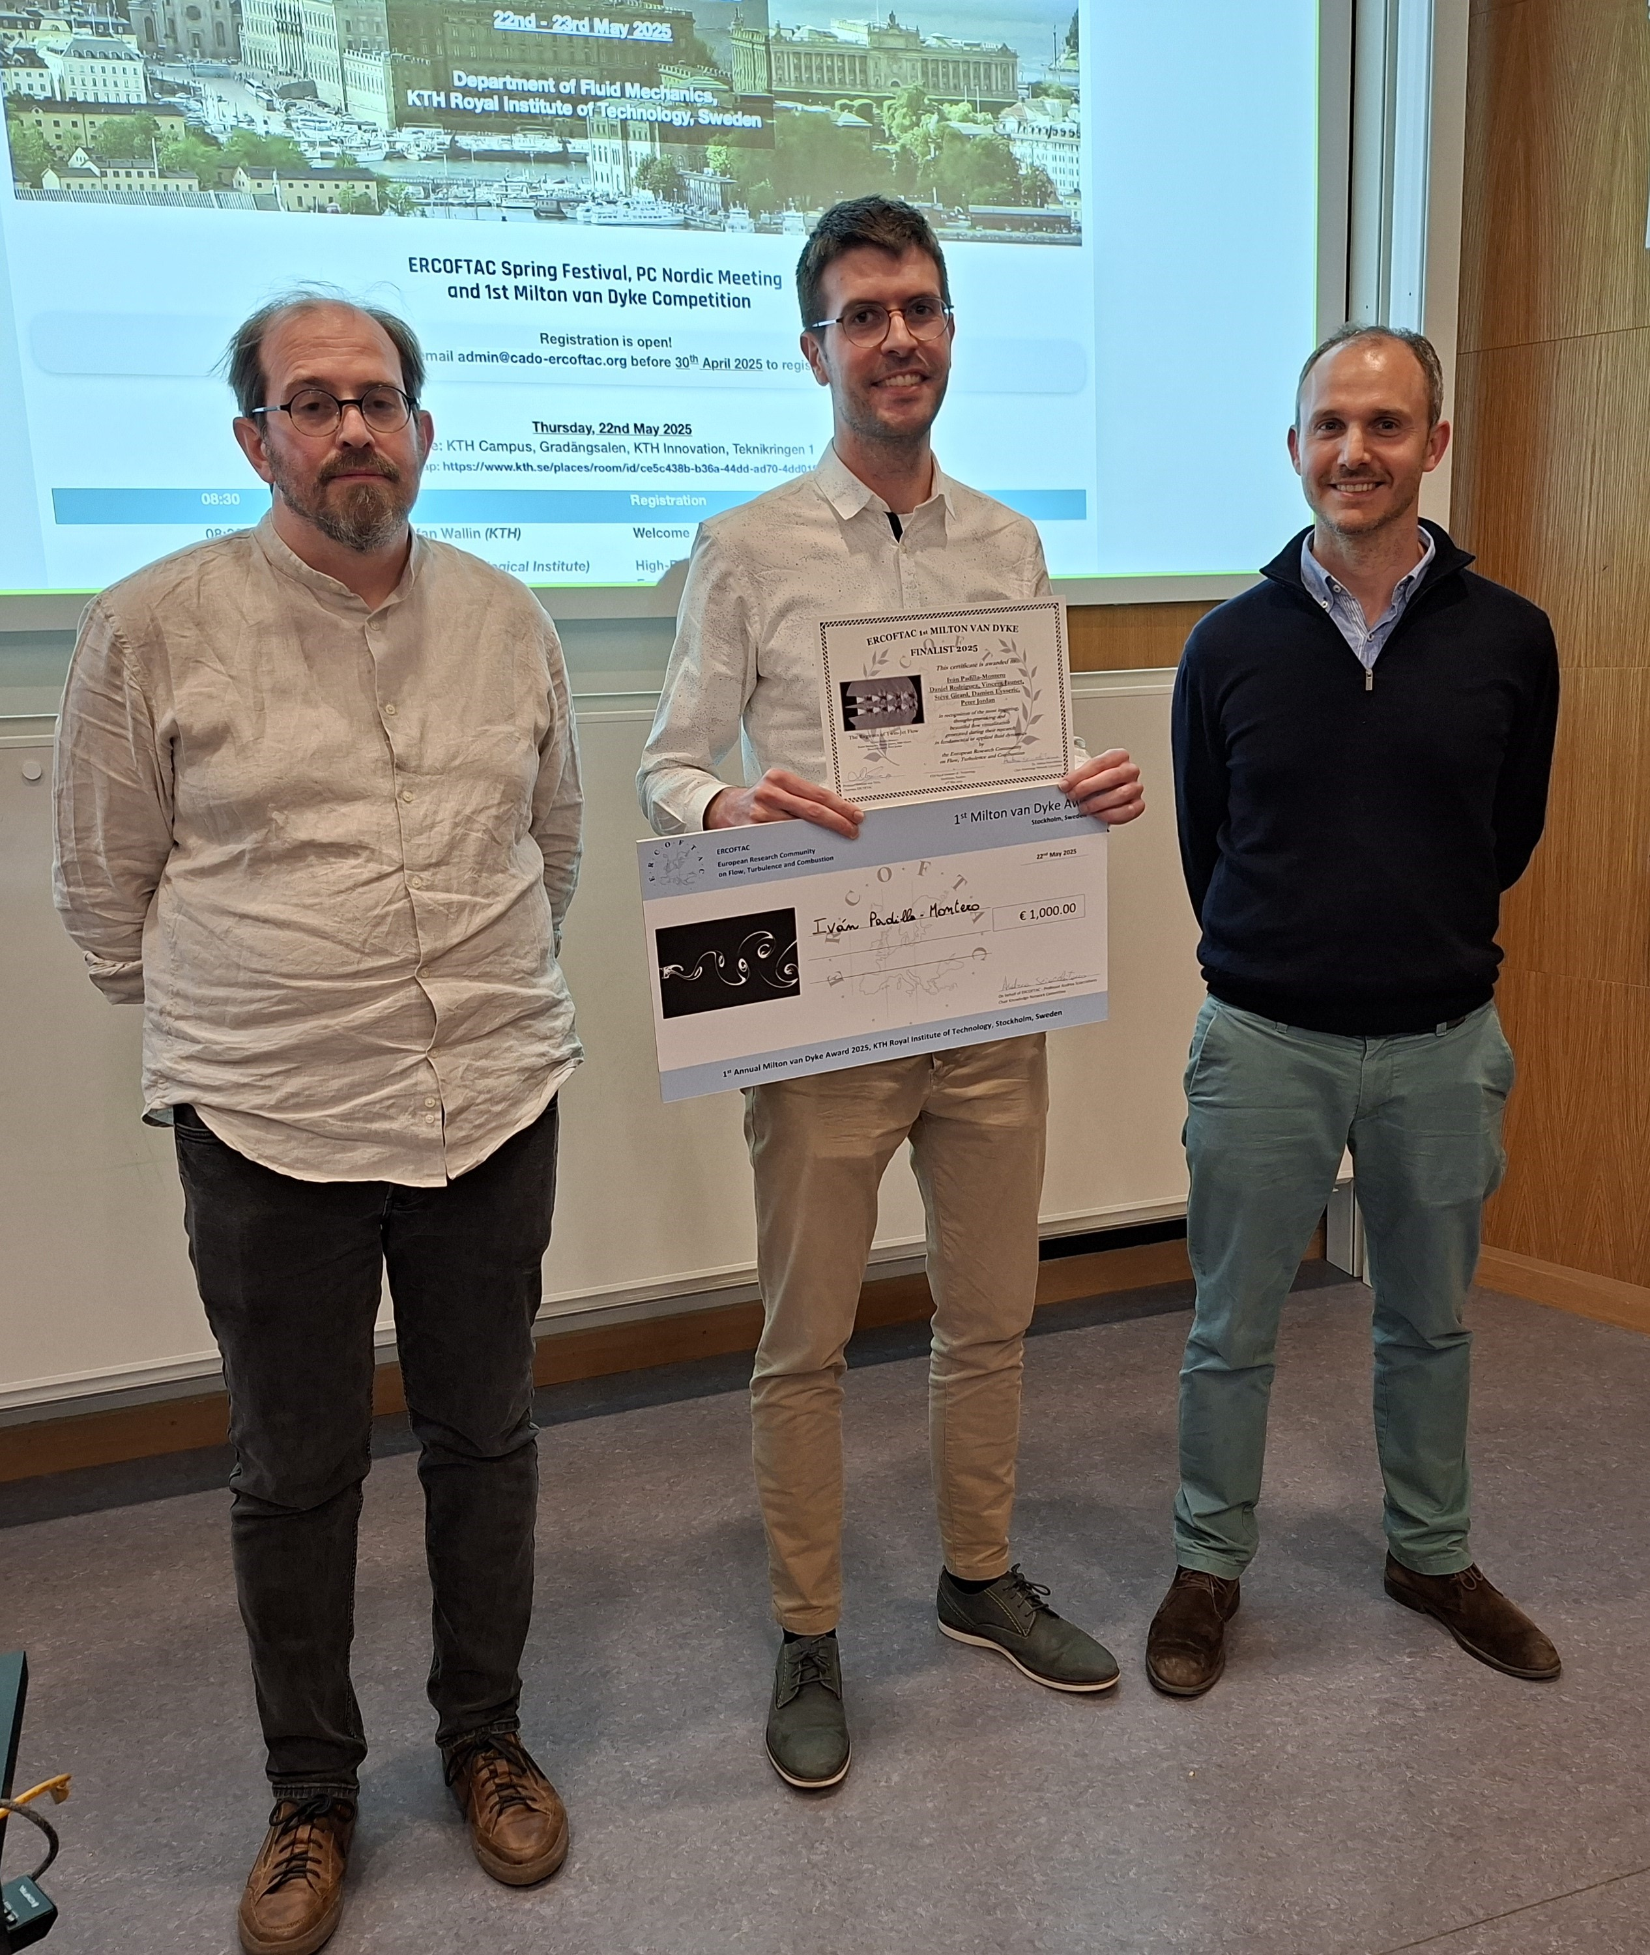
Milton van Dyke Flow Visualization Competition and €1,000 Prize
Annual prize for the most inspiring, thought-provoking or simply most beautiful flow visualization (image or animation, from experiments or simulation) generated during research in fundamental or applied fluid dynamics. The criterion is the aesthetics of the visualization. ERCOFTAC PC Coordinators provide the best nominations.
The winner of Milton van Dyke Competition receives €1,000 and is chosen from five finalists during the ERCOFTAC Spring Festivals
1st Winner of the 1st ERCOFTAC Milton van Dyke Competition: Iván Padilla-Montero
with
Daniel Rodríguez from ​Universidad Politécnica de Madrid, Spain and
Vincent Jaunet, Stève Girard, Damien Eysseric and Peter Jordan from (​Institut Pprime, Université de Poitiers – CNRS – ISAE/ENSMA, France
ERCOFTAC - 1st ERCOFTAC Milton van Dyke Competition 2025
https://www.ercoftac.org/about/ercoftac-milton-van-dyke-competition/

Slide 13
ERCOFTAC Activities:
COMPETITIONS:
- Da Vinci Competition and €1,000 Prize - Milton van Dyke Flow Visualization Competition and €1,000 Prize
PERIODIC EVENTS:
- Symposium on Engineering Turbulence Modelling and Measurements (ETMM) - Direct and Large Eddy Simulation (DLES)
WORKSHOP SERIES: - Machine Learning for Fluid Dynamics (ML4FLUID) - Young ERCOFTAC Spring School in Montestigliano
SIG/PC WORKSHOPS
INDUSTRIAL COURSES
KB WIKI - The World's foremost repository in the industrial application of CFD. Originally developed by the EU Network on Quality & Trust in the Industrial Application of CFD (QNET-CFD).
https://www.ercoftac.org/events/

Slide 14
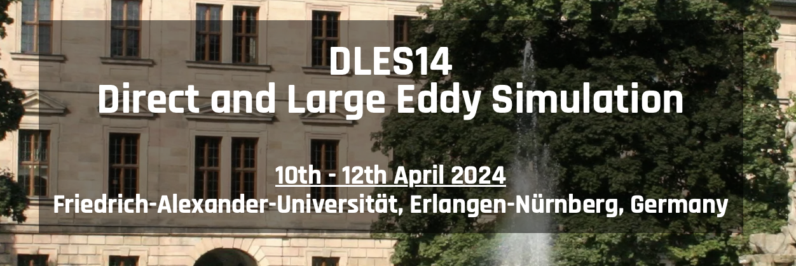
Periodic Events
Biannual Symposium Engineering Turbulence Modelling and Measurements - ETMM
22nd – 24th September 2025
Biannual Workshop on Direct and Large-Eddy Simulations – DLES
Next edition 2026
Annual Workshop on Machine Learning for Fluid Dynamics - ML4FLUIDS
4th – 6th March 2025
https://www.ercoftac.org/events/
Notes:
ERCOFTAC's activities include research projects, working groups, conferences, and training courses. We focus on advancing the understanding of turbulence and its impact on engineering systems, and on developing innovative solutions to complex engineering problems.

Slide 15
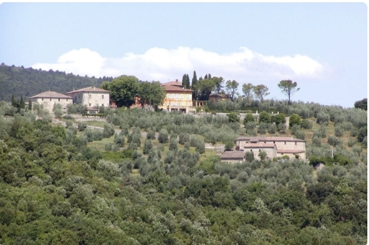
Young Spring School in Montestigliano Series
inaugurated in 2007, following an initiative of PC Germany South (Prof. W. Rodi) and endorsed by ERCOFTAC
takes place in the spring of each year at Montestigliano, Italy, a converted, former olive farm in Tuscany
attracts 12-15 students per year, across many countries and at various levels of their career
main scientific supervision is carried out by a principal invited speaker and the organizational team
Young ERCOFTAC Montestigliano Spring School for Graduate Students
team-building and cohort-training is enforced by the remote nature of the location
necessitates cooperation beyond the scientific projects: meals and other duties are shared by all participants
positive feedback gathered over the past twelve workshops attests to this:

Slide 16
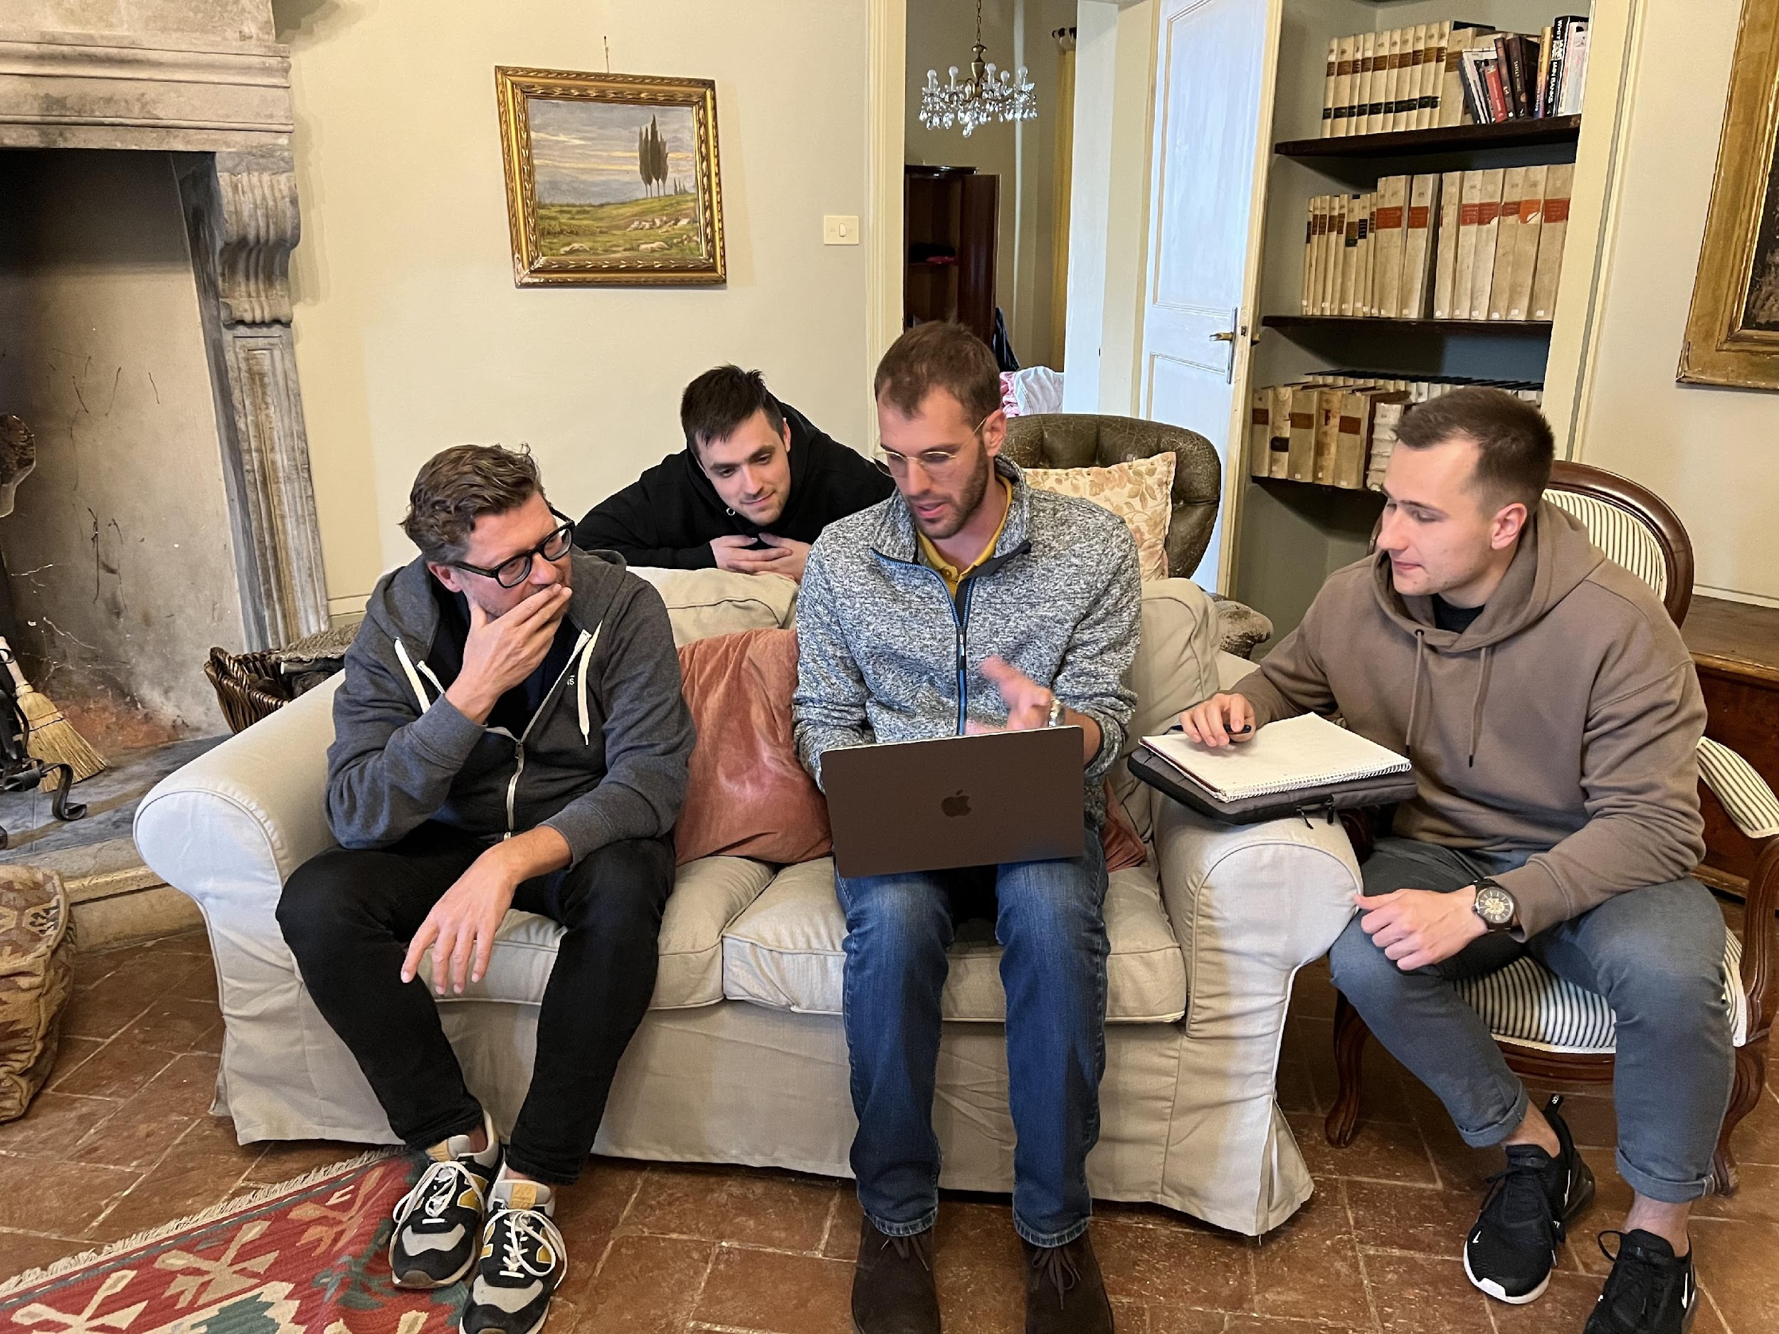
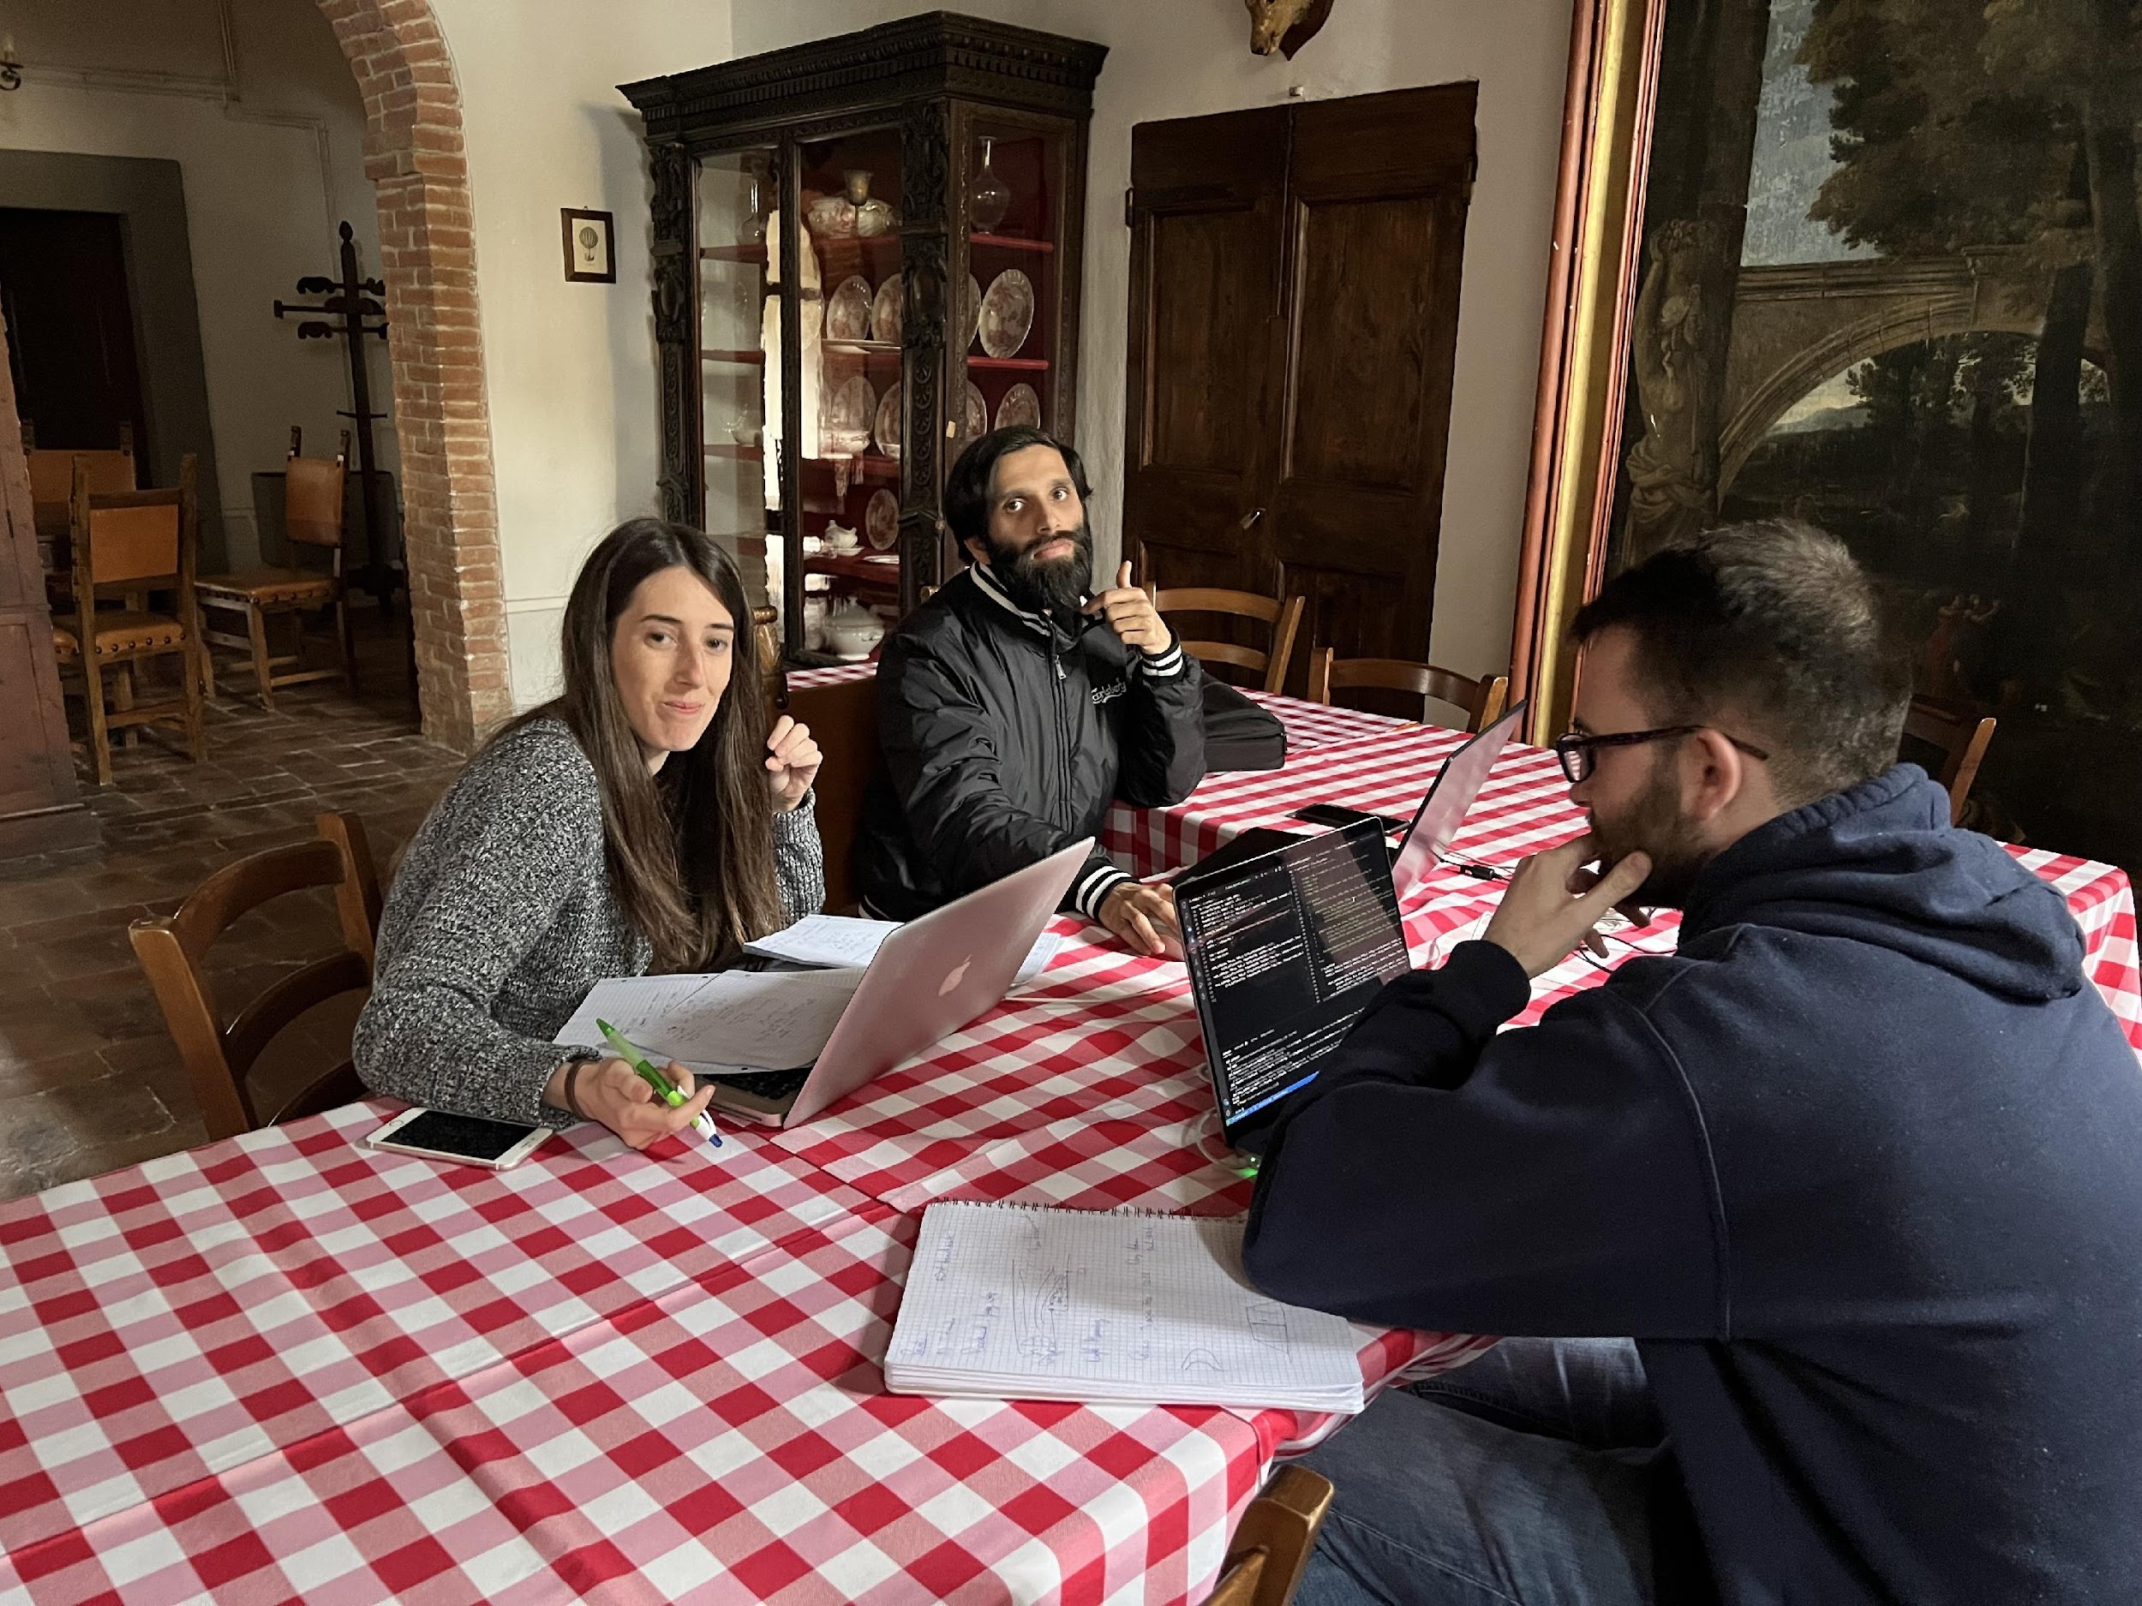
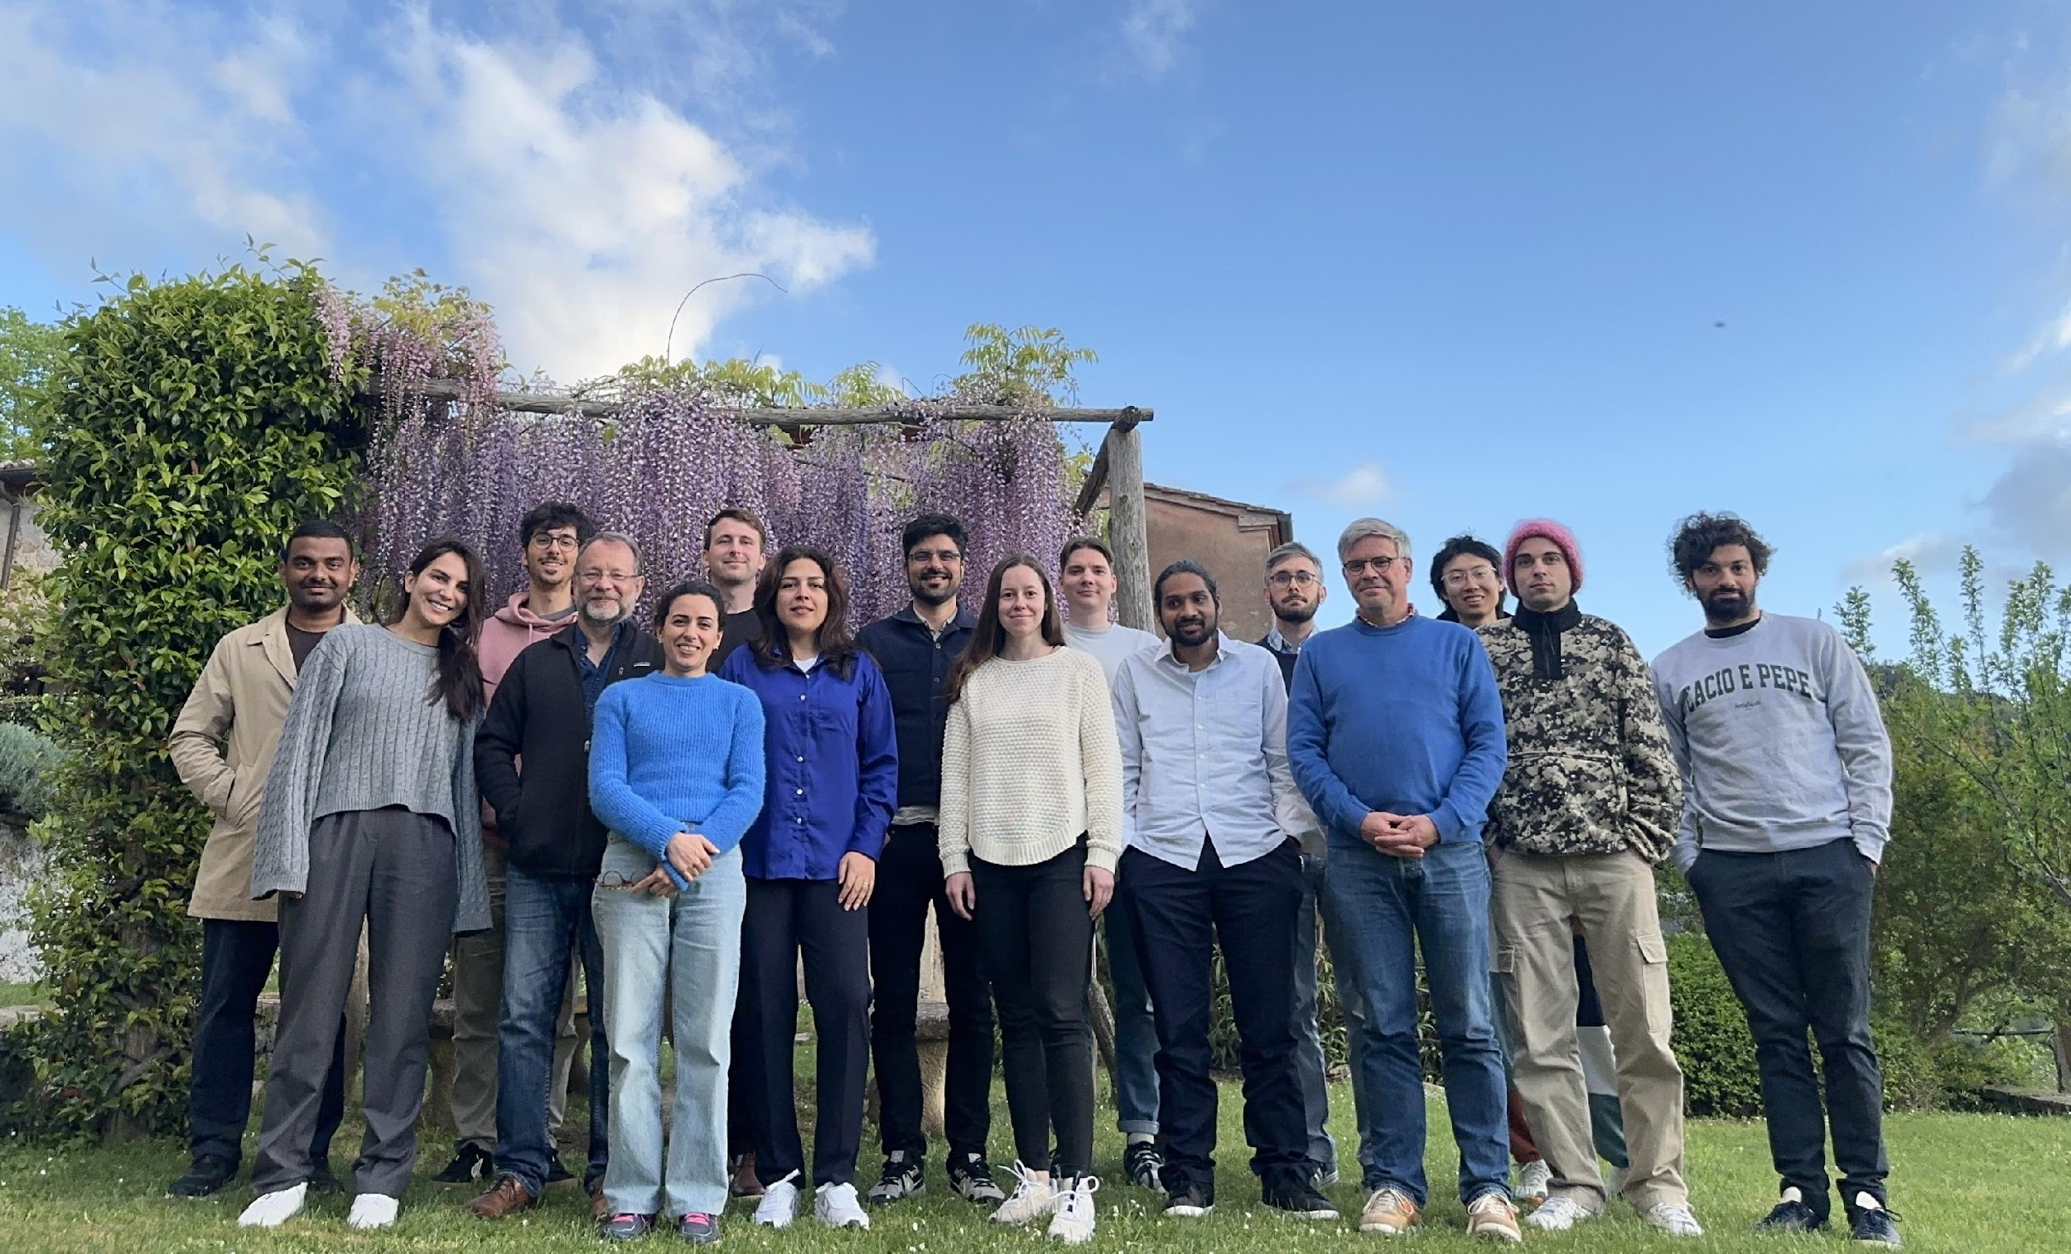
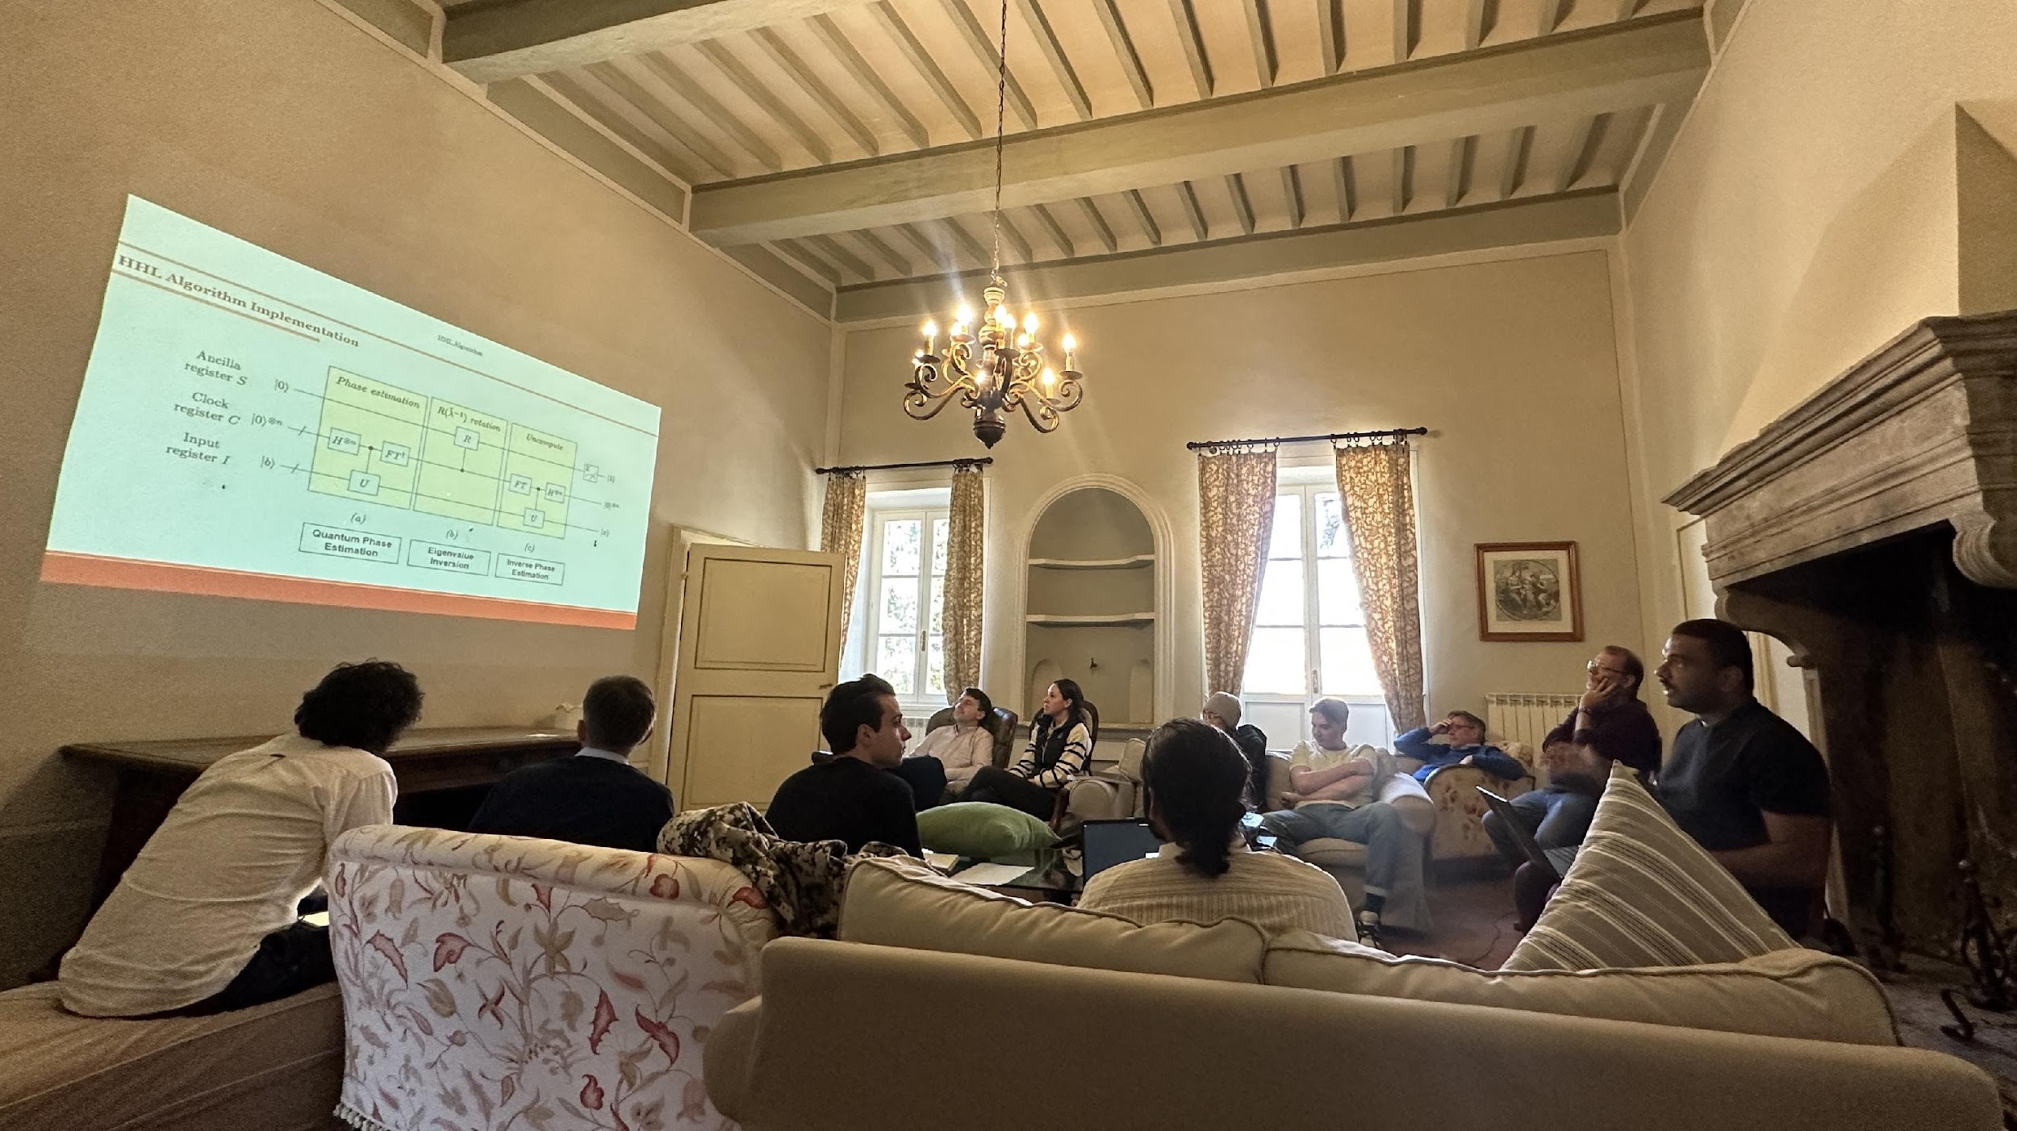
Young Spring School in Montestigliano Series
"Reflecting on my recent experience at the Young ERCOFTAC Montestigliano Spring School for Graduate Students 2024, I'm filled with gratitude for the invaluable opportunity it provided. Exploring Quantum Computing and its Application to Fluid Mechanics under the guidance of Prof Jörg Schumacher was truly enlightening. The interactive group sessions not only deepened my understanding of the subject but also fostered meaningful connections with fellow scholars. Against the backdrop of Montestigliano' s picturesque landscapes, learning became an immersive journey of growth and discovery. A heartfelt thank you to the organizers and mentors for curating such an enriching experience. Can't wait to see how this knowledge transforms our future endeavours!“- Nasrin Sahranavardfard "The event was a very enriching experience for me. The discussions I had with the organisers and my peers will help me go forward in my PhD journey. The Spring School in Montestigliano, Siena was a Perfect setting for a Holistic experience. The theme of the school Quantum Computing for Fluids gave me brief but precise knowledge about the developments and possibilities in the field. I would recommend early career researchers to have this experience. If given an opportunity I would attend the Spring school again next year. I thank ERCOFTAC for the opportunity and the Organisers for selecting me for this workshop“- Abhishek Joshi
Young ERCOFTAC Montestigliano Spring School for Graduate Students
https://www.ercoftac.org/about/young-ercoftac-spring-school-in-montestigliano/

Slide 17
Workshops, Summer Schools, Conferences and Courses
Aim:
organised by SIGs or PCs
to stimulate interactions between academia and industry to address industry relevant questions​
industry and academia participants and lecturers​ from around the world
results available to interested industry
Outcome:
dissemination of recent research
instruction in advanced topics
comparison of test cases
computer demonstrations of codes
discussions of new plans for collaborative research and improvement of codes
planning new experiments for comparison with computation
displays of work by SIGs
publication ERCOFTAC Bulletin
https://www.ercoftac.org/about/rules_for_holding_ercoftac_events/

Slide 18
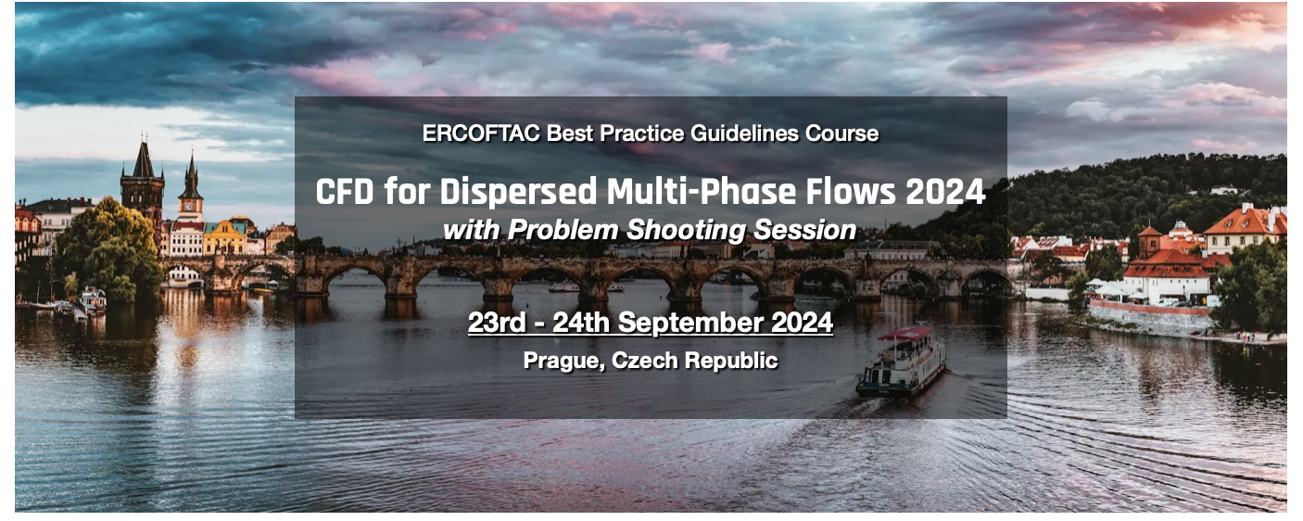
Workshops, Summer Schools, Conferences
Industrial Training Courses
https://www.ercoftac.org/events/
Notes:
ERCOFTAC's activities include research projects, working groups, conferences, and training courses. We focus on advancing the understanding of turbulence and its impact on engineering systems, and on developing innovative solutions to complex engineering problems.

Slide 19
Industrial Training Courses:
ERCOFTAC members can design the industrial courses in their field of knowledge and deliver them to a large number of recipients. ERCOFTAC CADO assists in administration process of preparation. Past courses included:
Uncertainty Management and Quantification in Industrial Analysis & Design
Design Optimization
Fluid Structure Interaction with Impact on Industrial Application
Computational Aeroacoustics
Lattice-Boltzmann Methods for Industrial Applications: Overview, Guidance & Examples
Wind Load on Structures 2018
ERCOFTAC BPG book series is also accompanied by a corresponding set of high-level courses:
CFD for Dispersed Multiphase Flows
CFD of Turbulent Combustion
Please contact ERCOFTAC CADO for more information: admin@cado-ercoftac.org

Slide 20
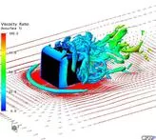
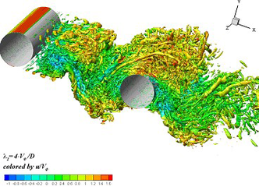
ERCOFTAC QNET-CFD Knowledge Base Wiki
introduces a new concept for collecting, structuring and sharing knowledge, best practice advice and guidelines for all CFD applications. It is continuously being enriched with the insight and experience of the world community.
Application Areas
These are sector disciplines such as Built Environment, Chemical and Process Engineering, External Aerodynamics, Turbomachinery, Combustion and Heat Transfer, Environmental Flows, Biomedical Flows etc.
Underlying Flow Regimes (UFR)
These are generic, well-studied test cases capturing important elements of the key flow physics encountered across the Application Areas.
Direct Numerical Simulations (DNS)
These are test cases providing statistical data from high-fidelity calculations, primarily Direct Numerical Simulations but also near-DNS Large Eddy simulations, aimed for testing and improving models for the turbulent motion and for gaining insight into this.
Experimental Studies (EXP)
These are test cases providing experimental data for gaining insight into the flow physics and supplying target values for testing and validating CFD methods
The KB Wiki is free to all visitors: http://www.kbwiki.ercoftac.org/
Notes:
ERCOFTAC's activities include research projects, working groups, conferences, and training courses. We focus on advancing the understanding of turbulence and its impact on engineering systems, and on developing innovative solutions to complex engineering problems.

Slide 21
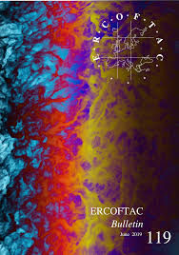
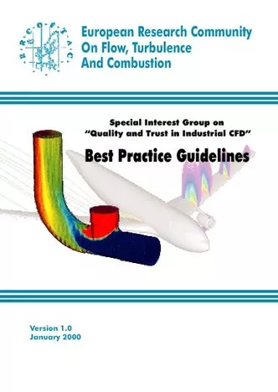
Publications
Events reports
PC and SIG reports
Thematic Issues
Bulletin
Industrial Computational Fluid Dynamics of Single-Phase Flows
Computational Fluid Dynamics of Dispersed Multi-Phase Flows
Computational Fluid Dynamics of Turbulent Combustion
Best Practice Guidelines
https://www.ercoftac.org/publications/
Notes:
ERCOFTAC's activities include research projects, working groups, conferences, and training courses. We focus on advancing the understanding of turbulence and its impact on engineering systems, and on developing innovative solutions to complex engineering problems.

Slide 22
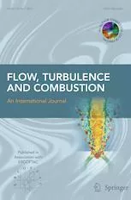
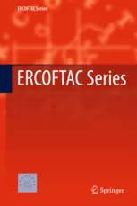
Publications
Flow, Turbulence and Combustion
The journal is published in association with ERCOFTAC. It is therefore expected that FTaC would be a primary medium for disseminating the most innovative and highest-quality scientific output of ERCOFTAC-supported technical events.
Springer Journal
https://link.springer.com/journal/10494
The ERCOFTAC Book Series is edited by the SPC and published by Springer, documenting proceedings of major ERCOFTAC meetings such as conferences and workshops and presenting contributed volumes on modern developments in FTAC or material taught at Summer Schools.
ERCOFTAC Book Series
https://www.springer.com/series/5934
https://www.ercoftac.org/publications/
Notes:
ERCOFTAC's activities include research projects, working groups, conferences, and training courses. We focus on advancing the understanding of turbulence and its impact on engineering systems, and on developing innovative solutions to complex engineering problems.

Slide 23
Membership
It is the main source of ERCOFTAC income. The funding for activities funding is defined by the payments received for membership.
Full voting membership fees for organisations are: €500 for research organisation €1000 for industrial organisation Membership fees for individuals are: €100 for individuals without receiving Bulletin €160 for individuals with Bulletin
https://www.ercoftac.org/about/ercoftac_membership/
Notes:
ERCOFTAC membership is open to universities, research institutions, and industry partners who are committed to advancing the field of turbulence research and engineering. Our members have access to a range of benefits, including access to our network of experts, training and education opportunities, and access to simulation tools.

Slide 24
Benefits of Membership
Participation in a network of international collaboration and exchange between industry and research.
First FREE copy of two ERCOFTAC BPG Books. Reduced price for any subsequent copies of ERCOFTAC BPG Books
Substantial reductions on registration fees for courses, seminars, workshops etc. organised or sponsored by ERCOFTAC.
Reception, free of charge, of the ERCOFTAC Bulletin
Priority in access to the most recent results of joint research projects in discussion/undertaken in ERCOFTAC SIGs
Participation in a Pilot Centre that provides contacts and can help to obtain national support for research activities.
Possibility to apply for scholarship funding for young researchers to participate in activities organised or sponsored by ERCOFTAC.
https://www.ercoftac.org/about/ercoftac_membership/
Notes:
ERCOFTAC provides a range of benefits to its members, including training and education, access to simulation tools, and collaboration and networking opportunities.

Slide 25
Benefits of Membership
Reduced subscription rate for the Journal of Flow Turbulence and Combustion.
Possibility to prepare and organise workshops, summer schools, conferences and courses which can be supported by ERCOFTAC (financially and administratively)
Receiving, through the ERCOFTAC network, support in preparing proposals for European Community research and training programs
Updates about the ERCOFTAC QNET Knowledge Base Wiki.
Possibility to use ERCOFTAC website and its communication channels to advertise new job opportunities
https://www.ercoftac.org/about/ercoftac_membership/
Notes:
ERCOFTAC provides a range of benefits to its members, including training and education, access to simulation tools, and collaboration and networking opportunities.

Slide 26
ERCOFTAC Members on the benefits of membership…
"Interested in DLES and ETMM conferences because they are relatively small and they allow junior researchers to spend time with more senior colleagues from other organisations (also registration fees are discounted for members)”
"A source of community and workshop events in FTAC”
"Connects different members from many areas of interests: engine combustion with alternative fuels (ammonia, hydrogen, methanol), RANS and scale resolving (LES) methods”
"Useful in helping establish links to other research institutions”
"The BPGs have been very well received and are useful for both CFD and combustion modelling”
"The students can present their research at the ERCOFTAC Festivals”

Slide 27
ERCOFTAC Members on the benefits of membership…
"It is interesting and useful to be a part of the Community. It gives the scientist the opportunity to improve. And also global scientific problems can be solved by joint research”
"Knowledge and access to the beneficial events and materials”
"Overview of who is working on what topic at the moment”
"A good opportunity to connect with colleagues, in particular through the conferences and workshops”
"Valuable and interesting initiatives undertaken by the community both on research (such as conferences, workshops) and education (e.g. summer schools). Enjoyable and lively exchange of ideas during the Spring and Autumn Festivals”
"We regularly use the Classic Database as a resource for MSc programme training”

Slide 28
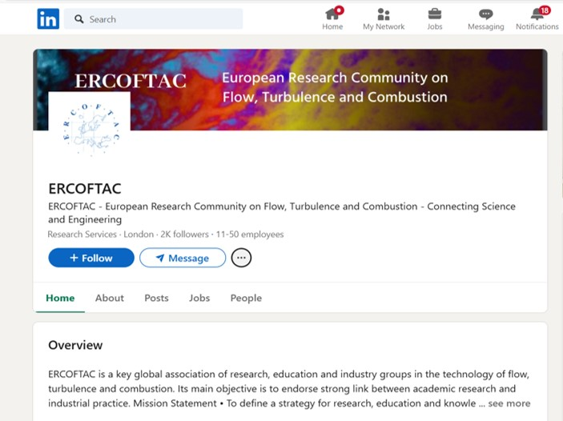
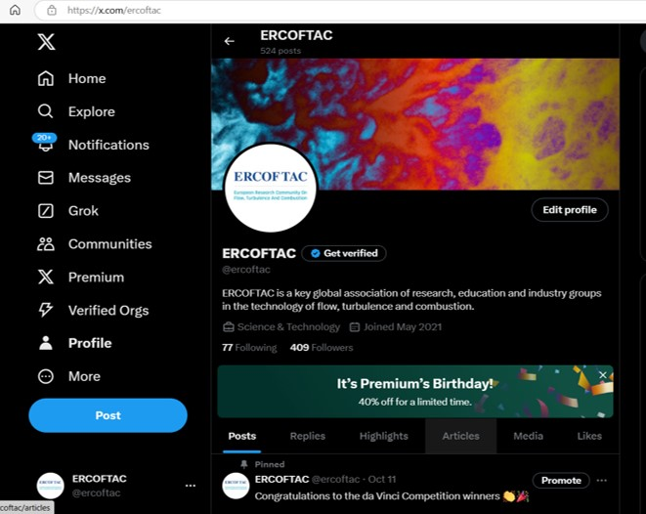
ERCOFTAC on Social Media:
Please follow us on social media: LinkedIn, X (Twitter)

Slide 29
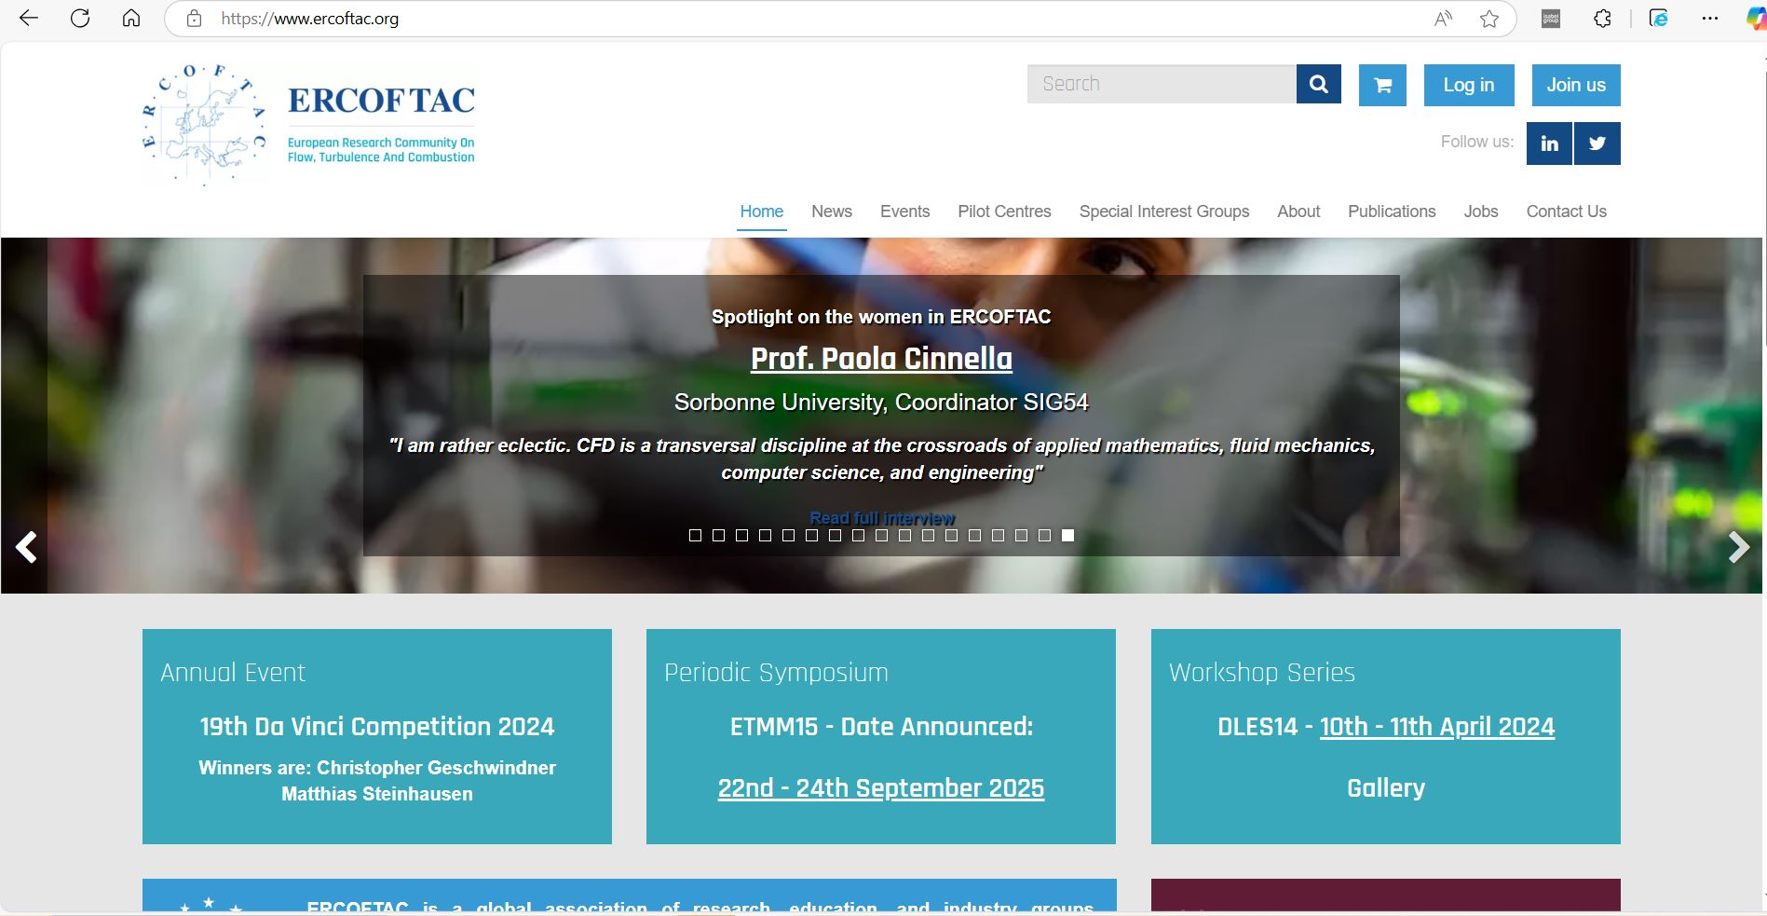
ERCOFTAC
ERCOFTAC is Non - Profit Organisation Registration Number is: AISBL BE 435 391 032, Non subject to VAT.
Registration address: ERCOFTAC, Chaussée de la Hulpe 189, Terhulpsesteenweg, 1170 Brussels, Belgium
Administration office address: Central Administration and Development Office (CADO), PO Box 1212, Bushey, WD23 9HT, United Kingdom
Email: admin@cado-ercoftac.org
Website: www.ercoftac.org
European Research Community in Flow, Turbulence and Combustion
Notes:
AI-generated content may be incorrect. --- ERCOFTAC is a leading European association in the field of turbulence research and engineering. In this presentation, we will explore the mission, structure, and benefits of ERCOFTAC.

